Slide 1
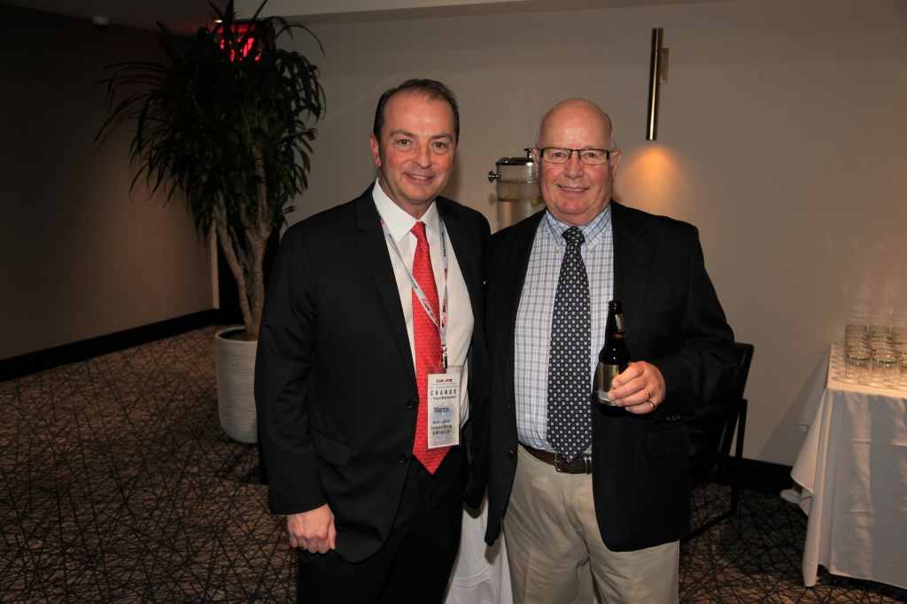
Canadian Association of Movers 2017 Annual Awards Dinner in Montreal, QC

Slide 2
Canadian Association of Movers 2017 Annual Awards Dinner in Montreal, QC

Slide 3
Canadian Association of Movers 2017 Annual Awards Dinner in Montreal, QC

Slide 4
Canadian Association of Movers 2017 Annual Awards Dinner in Montreal, QC

Slide 5
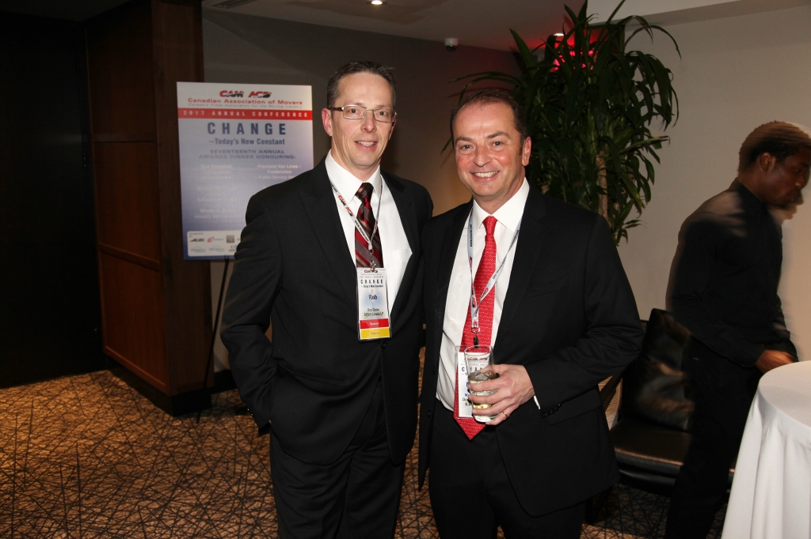
Canadian Association of Movers 2017 Annual Awards Dinner in Montreal, QC

Slide 6
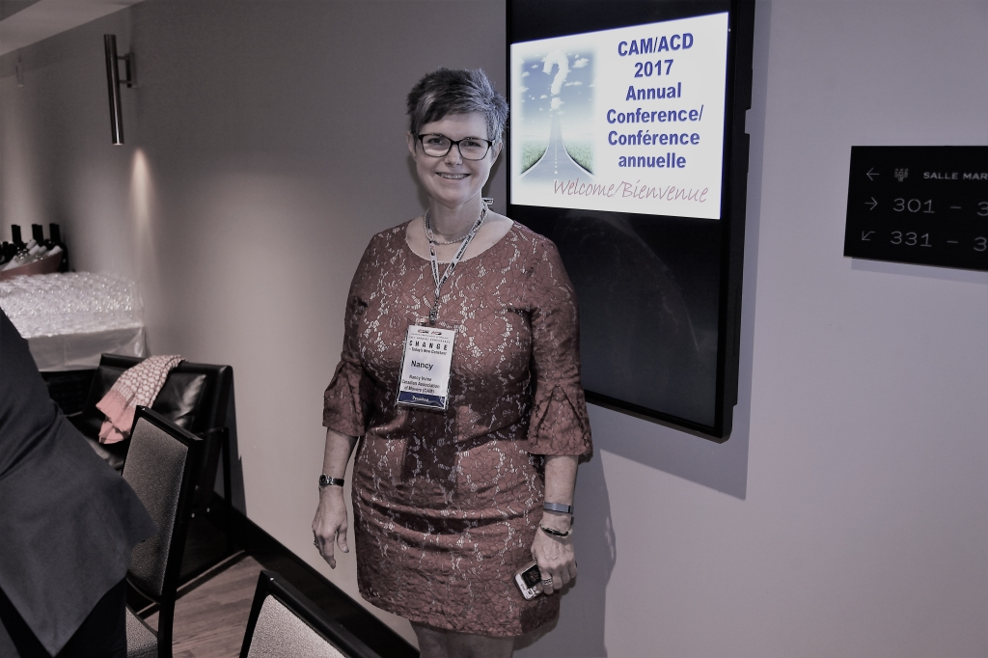
Canadian Association of Movers 2017 Annual Awards Dinner in Montreal, QC

Slide 7
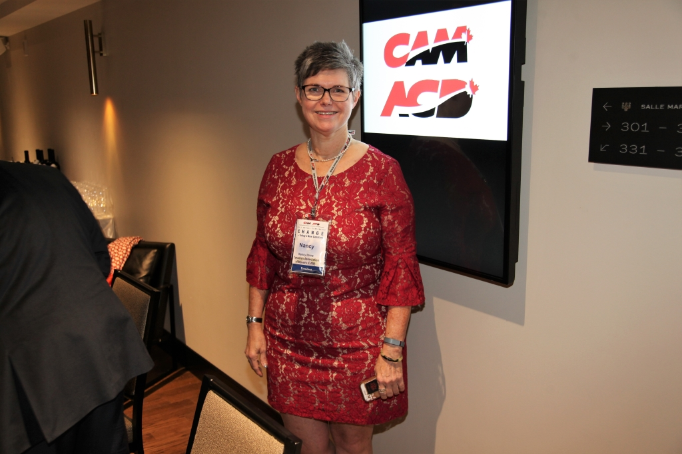
Canadian Association of Movers 2017 Annual Awards Dinner in Montreal, QC

Slide 8
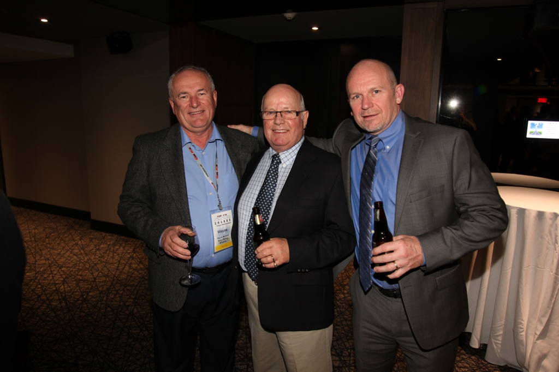
Canadian Association of Movers 2017 Annual Awards Dinner in Montreal, QC

Slide 9
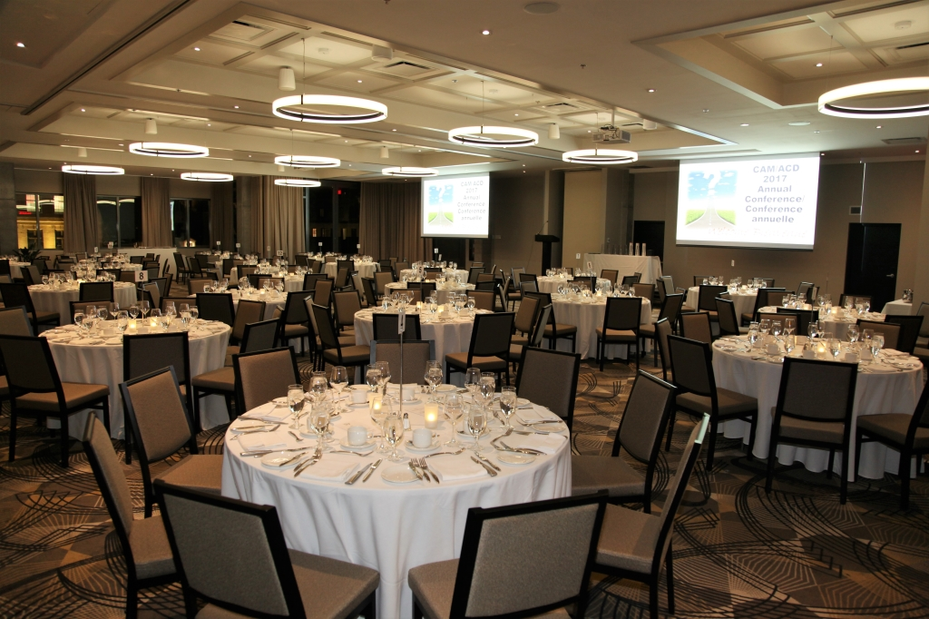
Canadian Association of Movers 2017 Annual Awards Dinner in Montreal, QC

Slide 10
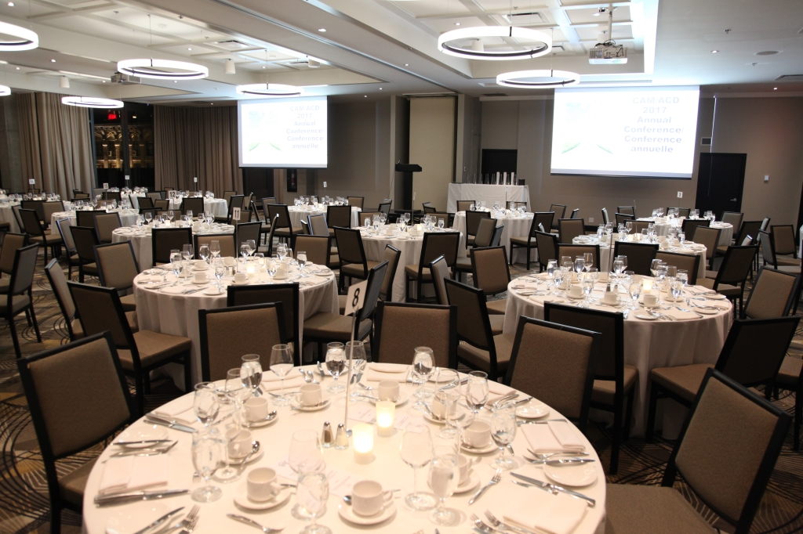
Canadian Association of Movers 2017 Annual Awards Dinner in Montreal, QC

Slide 11
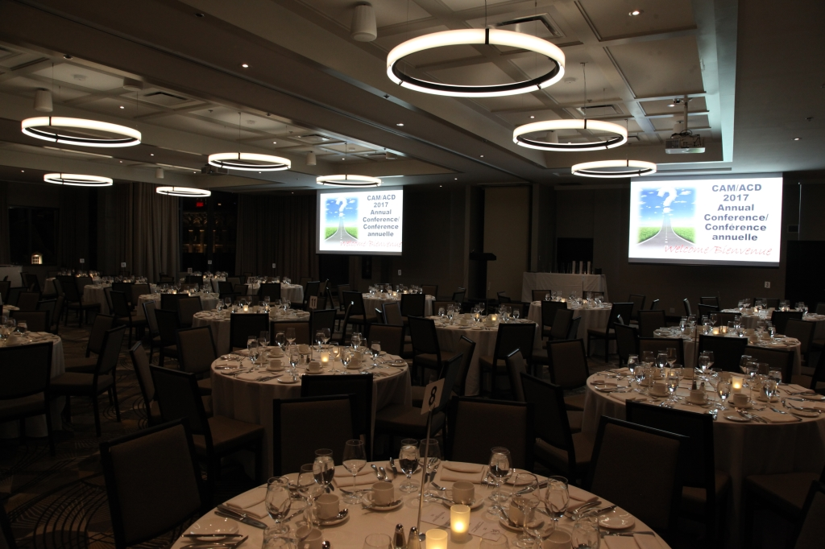
Canadian Association of Movers 2017 Annual Awards Dinner in Montreal, QC

Slide 12
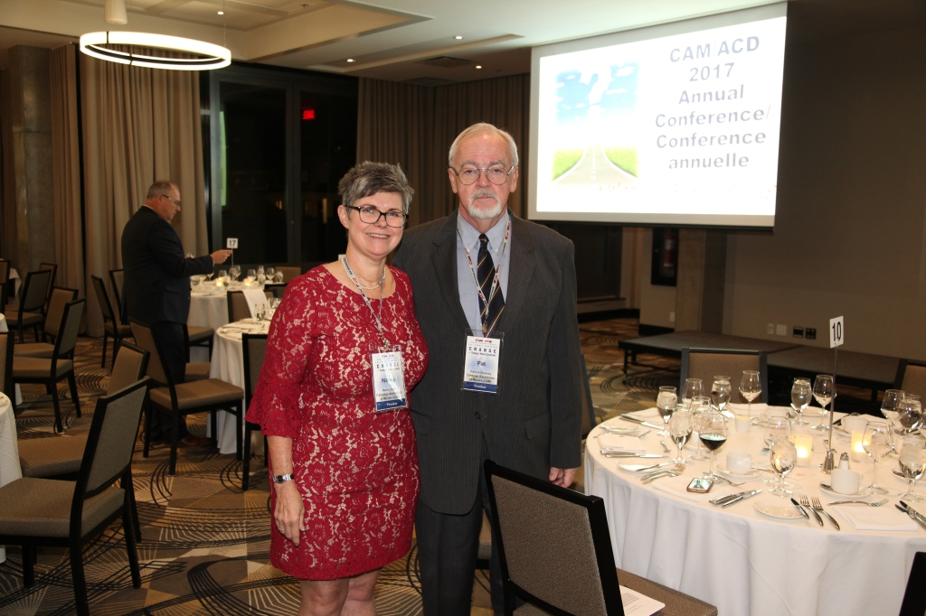
Canadian Association of Movers 2017 Annual Awards Dinner in Montreal, QC

Slide 13
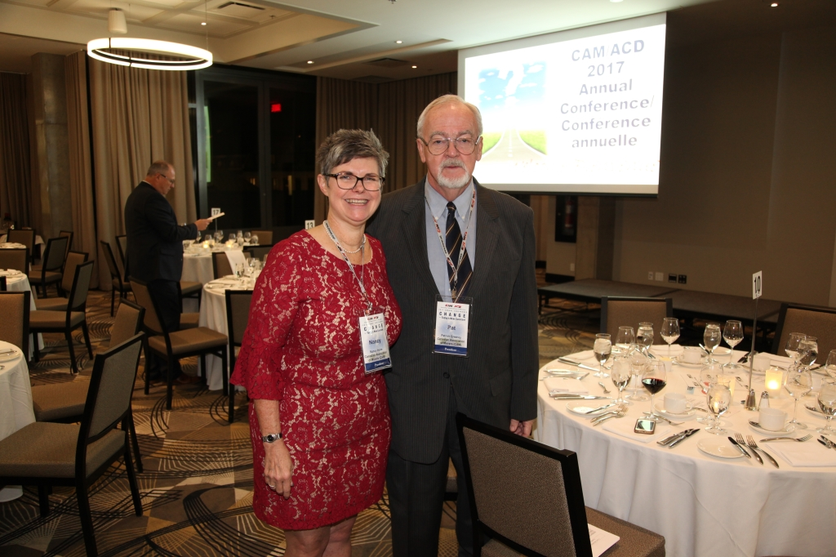
Canadian Association of Movers 2017 Annual Awards Dinner in Montreal, QC

Slide 14
Canadian Association of Movers 2017 Annual Awards Dinner in Montreal, QC

Slide 15
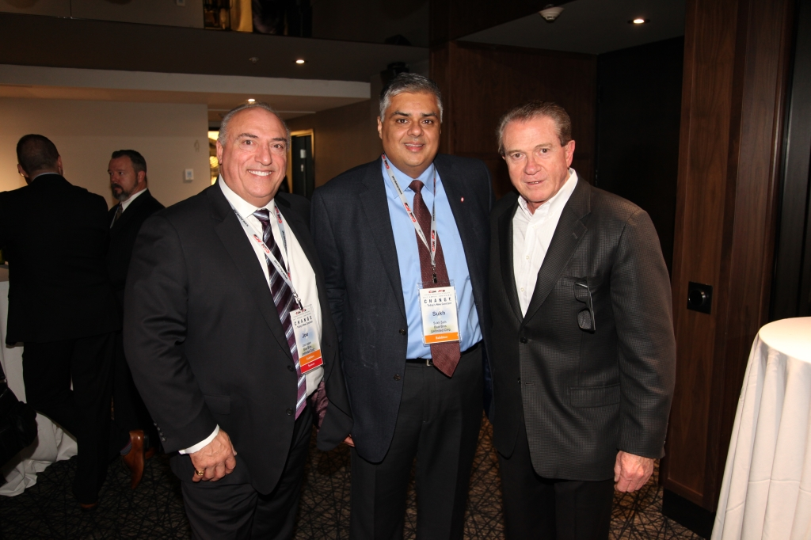
Canadian Association of Movers 2017 Annual Awards Dinner in Montreal, QC

Slide 16
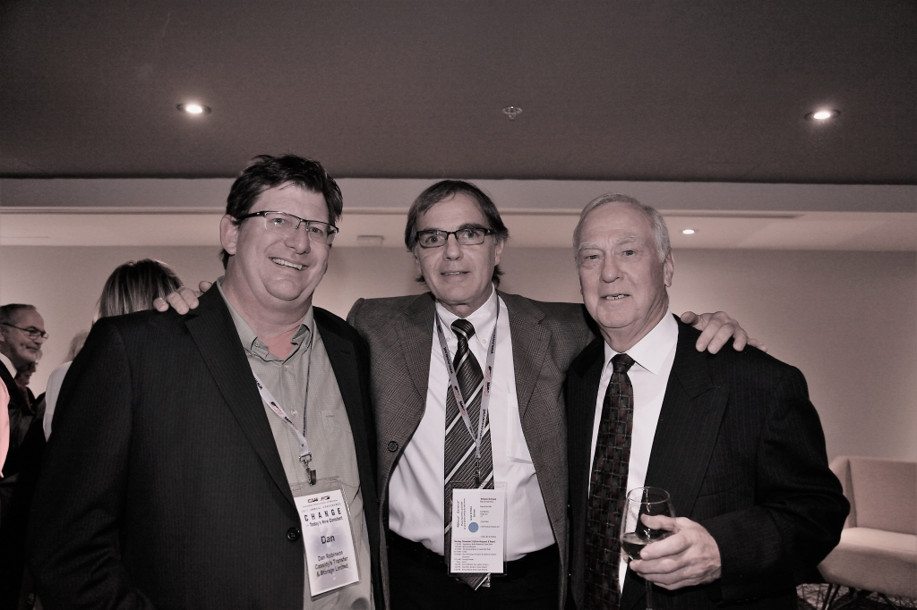
Canadian Association of Movers 2017 Annual Awards Dinner in Montreal, QC

Slide 17
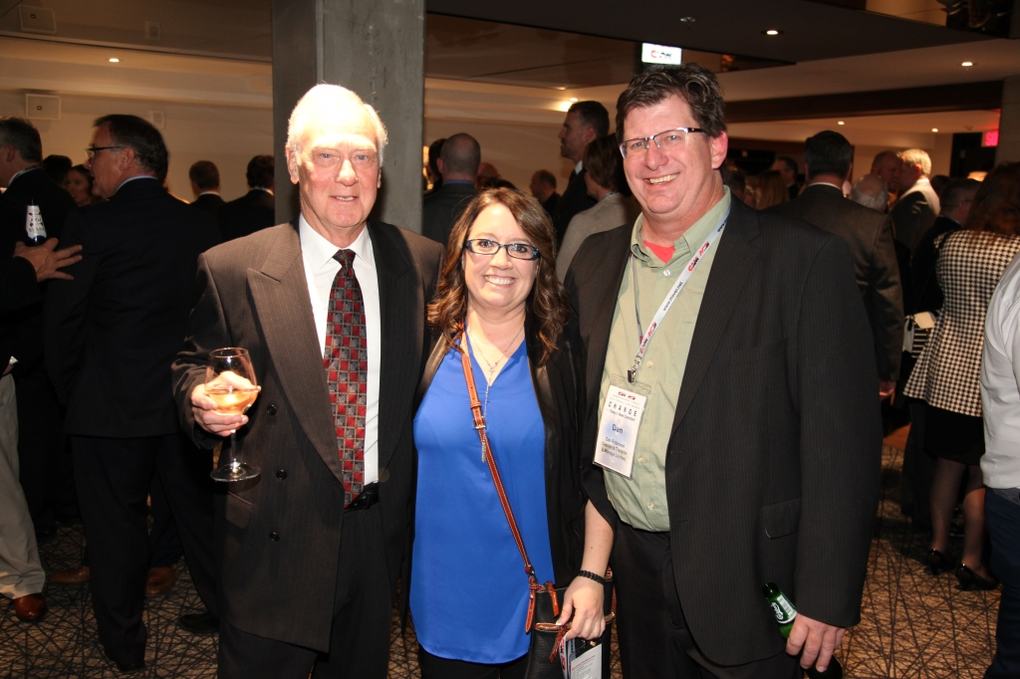
Canadian Association of Movers 2017 Annual Awards Dinner in Montreal, QC

Slide 18
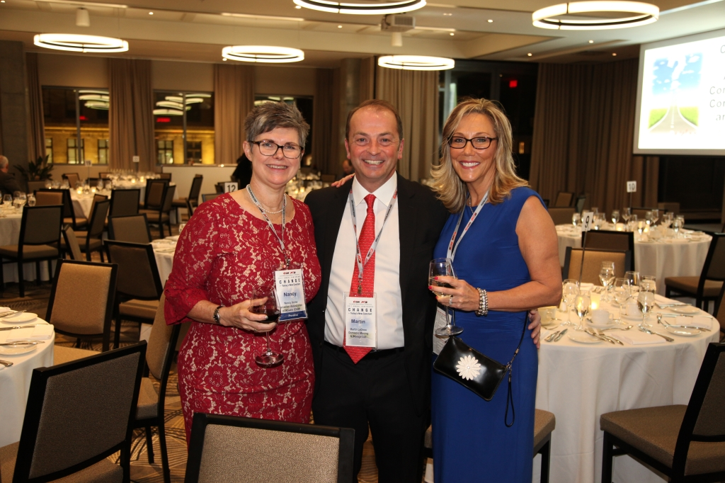
Canadian Association of Movers 2017 Annual Awards Dinner in Montreal, QC

Slide 19
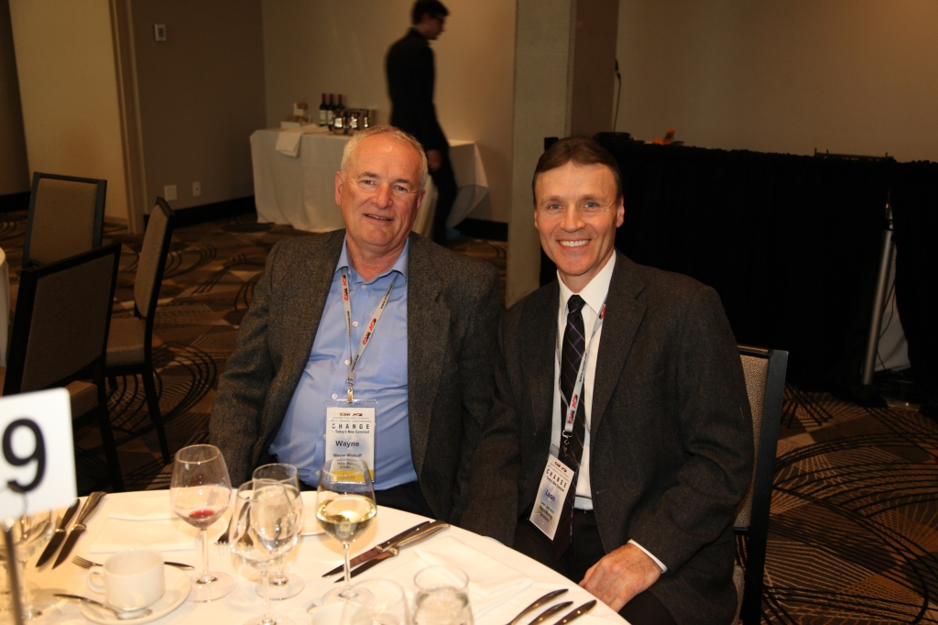
Canadian Association of Movers 2017 Annual Awards Dinner in Montreal, QC

Slide 20
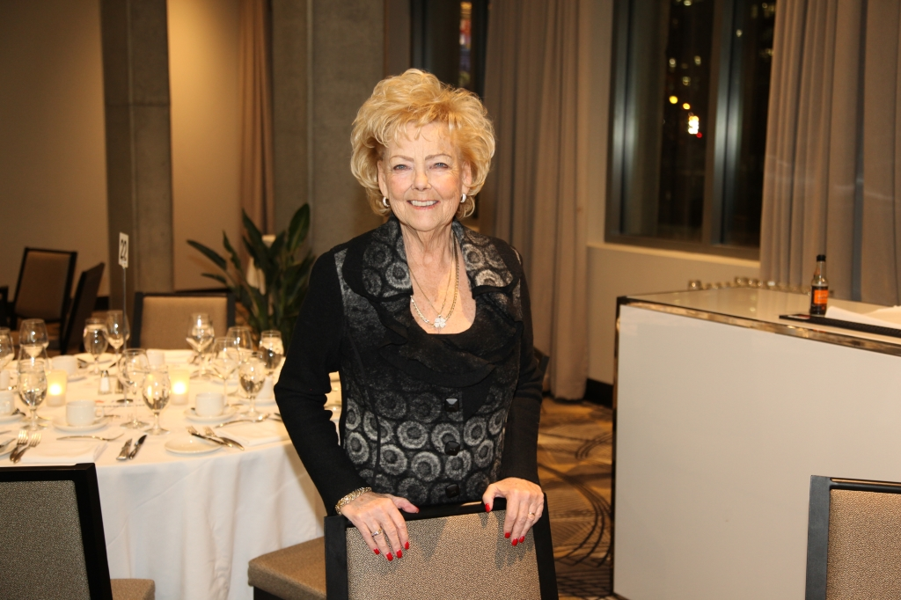
Canadian Association of Movers 2017 Annual Awards Dinner in Montreal, QC

Slide 21
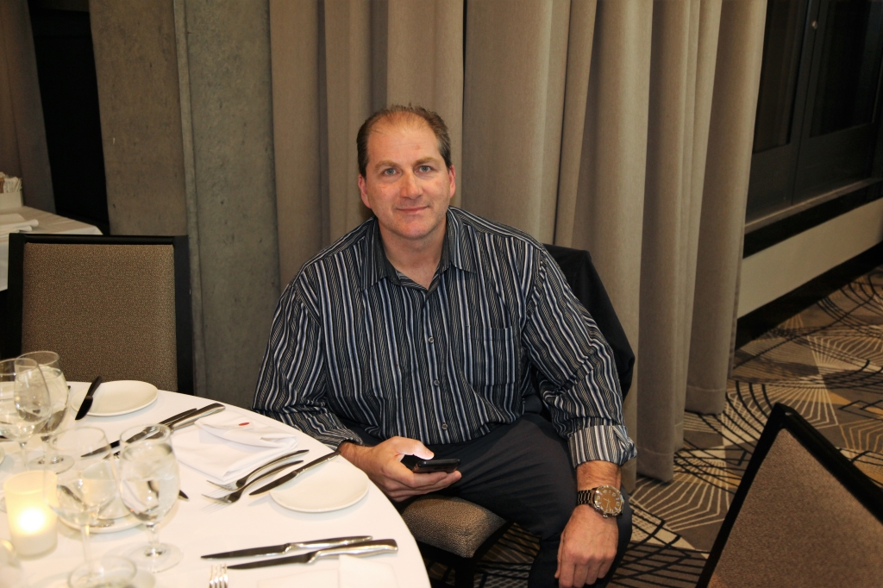
Canadian Association of Movers 2017 Annual Awards Dinner in Montreal, QC

Slide 22
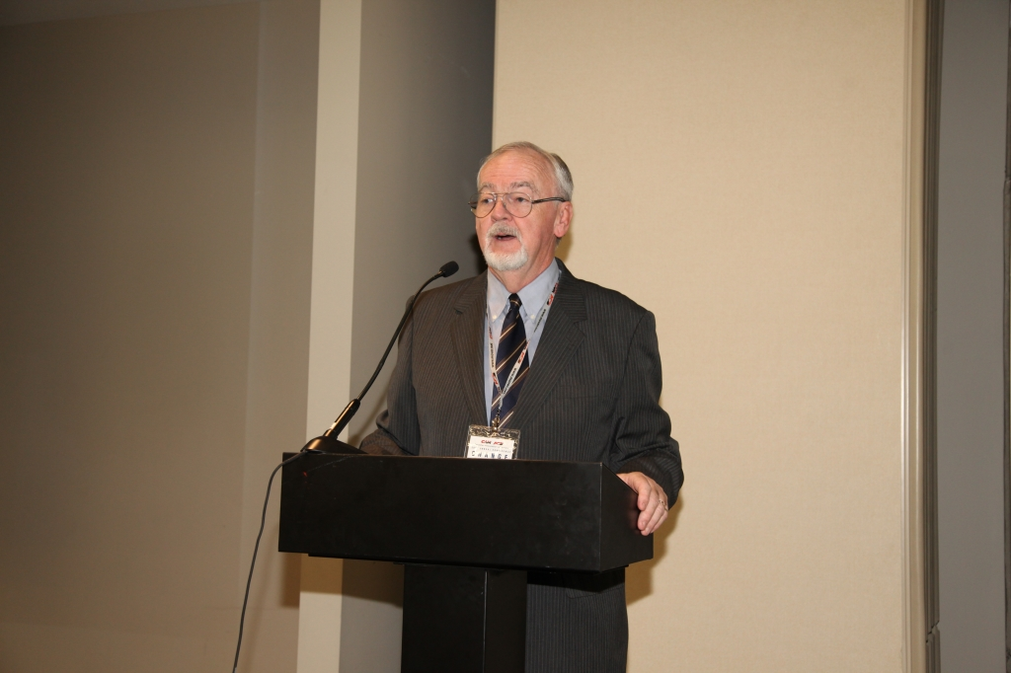
Canadian Association of Movers 2017 Annual Awards Dinner in Montreal, QC

Slide 23
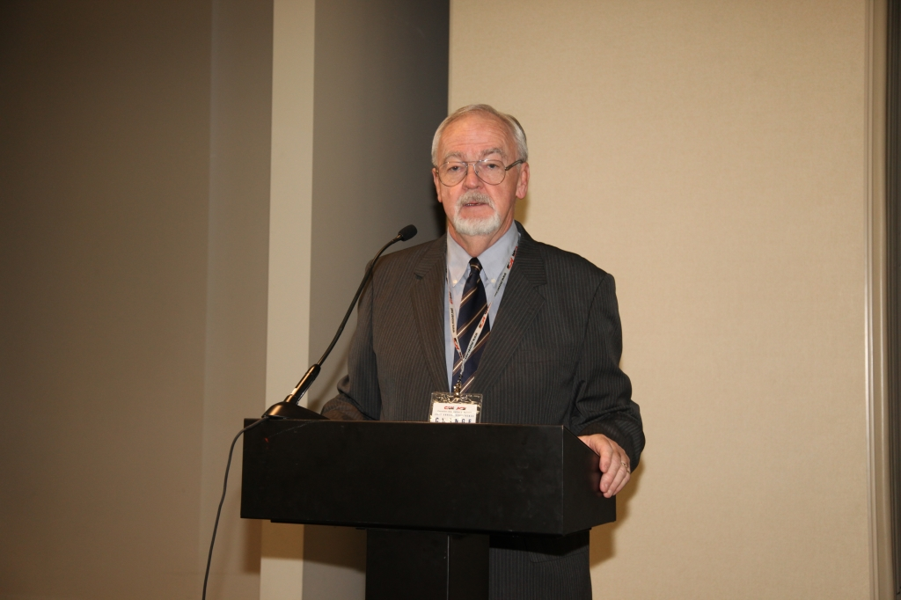
Canadian Association of Movers 2017 Annual Awards Dinner in Montreal, QC

Slide 24
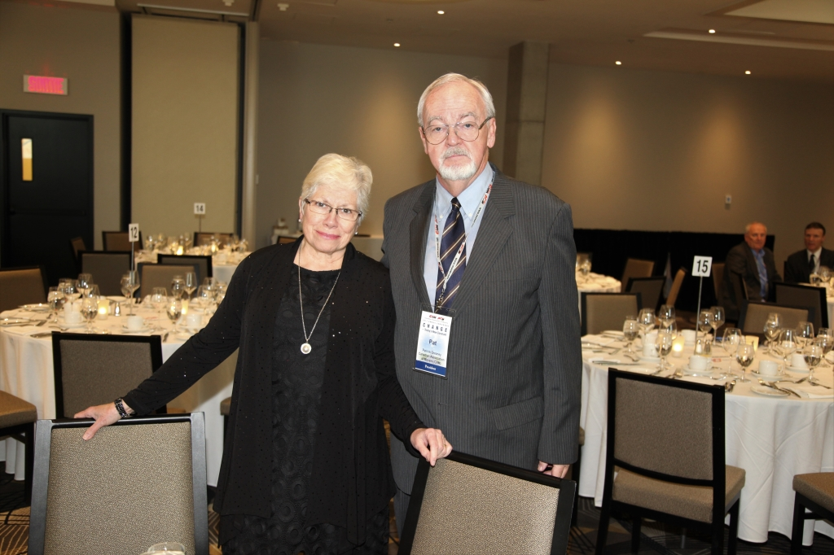
Canadian Association of Movers 2017 Annual Awards Dinner in Montreal, QC

Slide 25
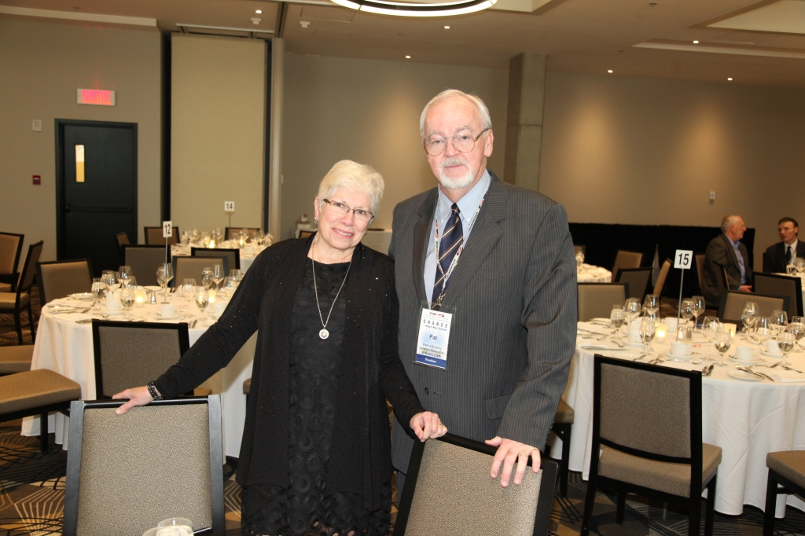
Canadian Association of Movers 2017 Annual Awards Dinner in Montreal, QC

Slide 26
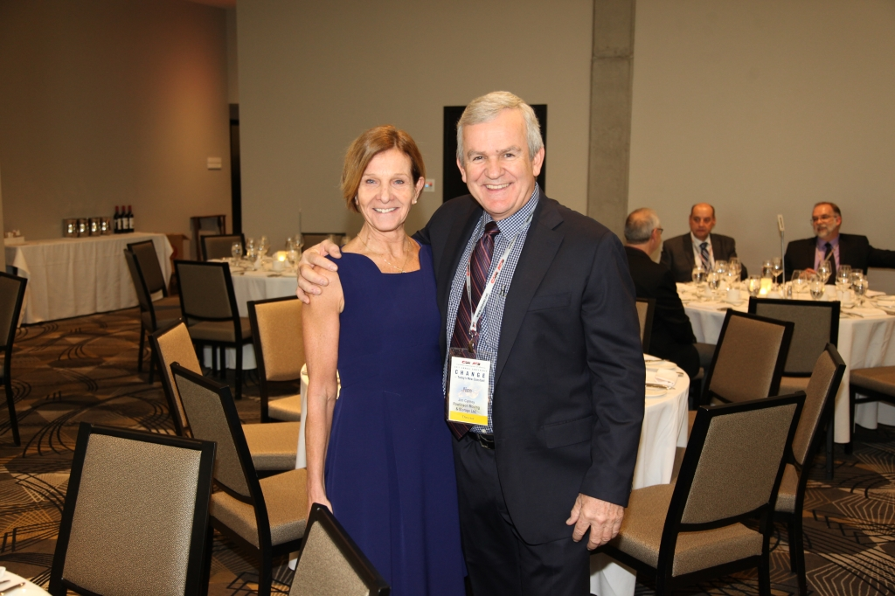
Canadian Association of Movers 2017 Annual Awards Dinner in Montreal, QC

Slide 27
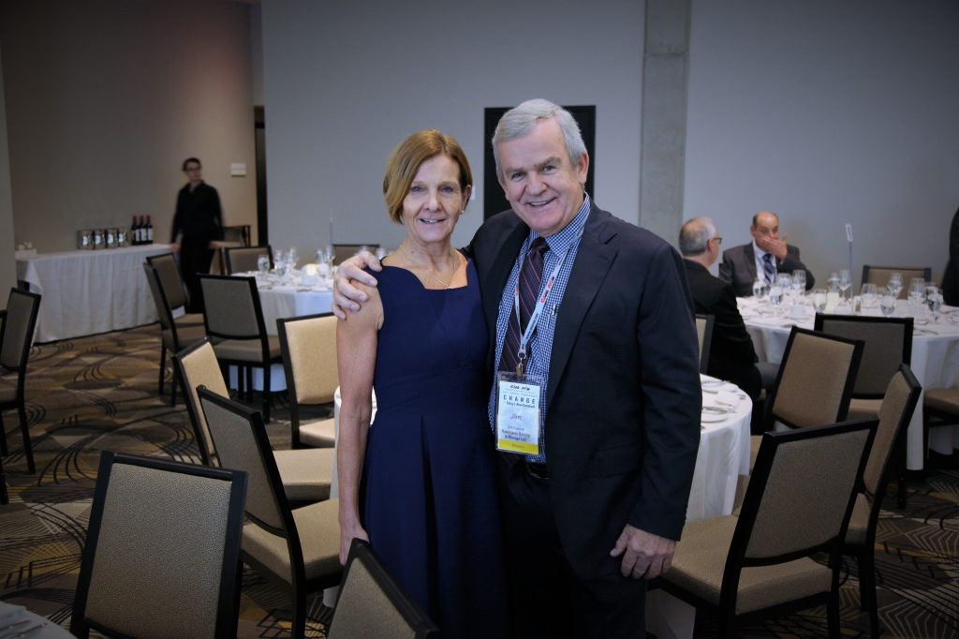
Canadian Association of Movers 2017 Annual Awards Dinner in Montreal, QC

Slide 28
Canadian Association of Movers 2017 Annual Awards Dinner in Montreal, QC

Slide 29
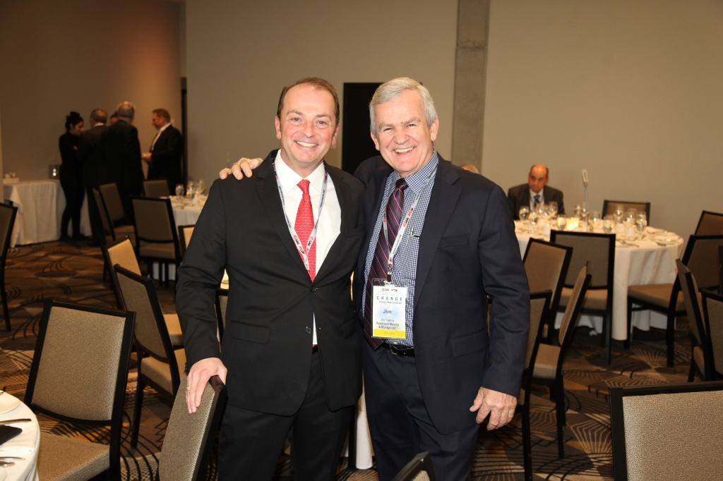
Canadian Association of Movers 2017 Annual Awards Dinner in Montreal, QC

Slide 30
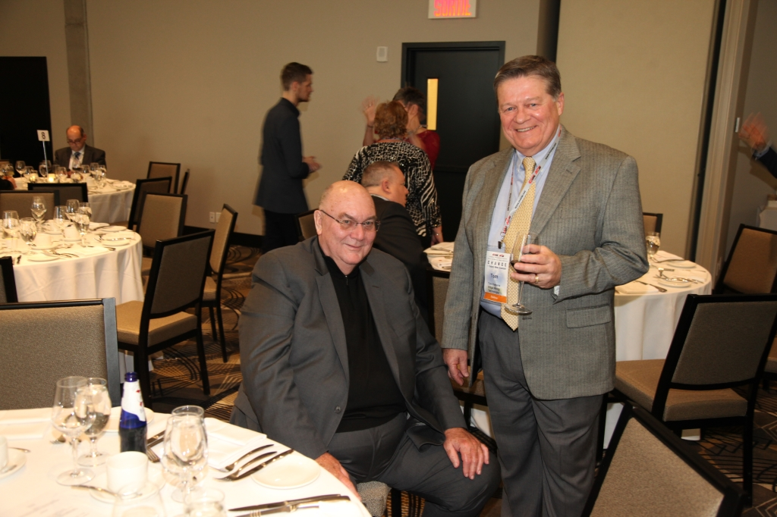
Canadian Association of Movers 2017 Annual Awards Dinner in Montreal, QC

Slide 31
Canadian Association of Movers 2017 Annual Awards Dinner in Montreal, QC

Slide 32
Canadian Association of Movers 2017 Annual Awards Dinner in Montreal, QC

Slide 33
Canadian Association of Movers 2017 Annual Awards Dinner in Montreal, QC

Slide 34
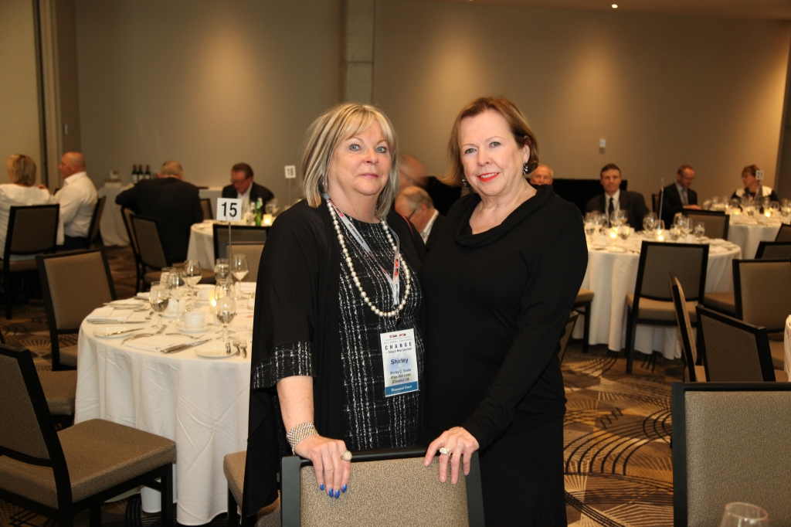
Canadian Association of Movers 2017 Annual Awards Dinner in Montreal, QC

Slide 35
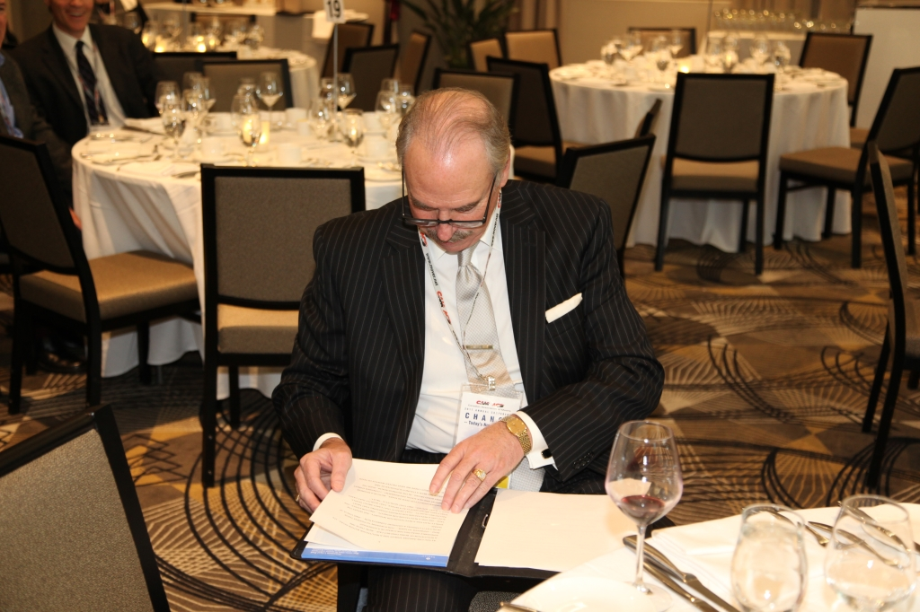
Canadian Association of Movers 2017 Annual Awards Dinner in Montreal, QC

Slide 36
Canadian Association of Movers 2017 Annual Awards Dinner in Montreal, QC

Slide 37
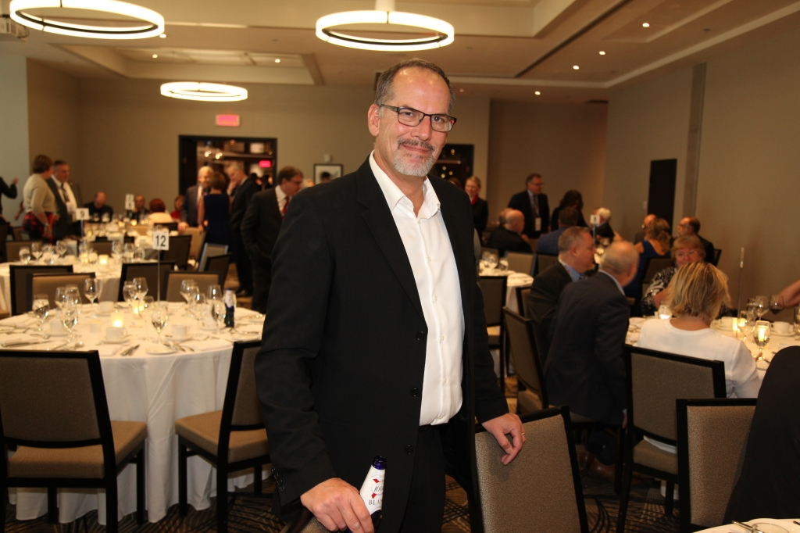
Canadian Association of Movers 2017 Annual Awards Dinner in Montreal, QC

Slide 38
Canadian Association of Movers 2017 Annual Awards Dinner in Montreal, QC

Slide 39
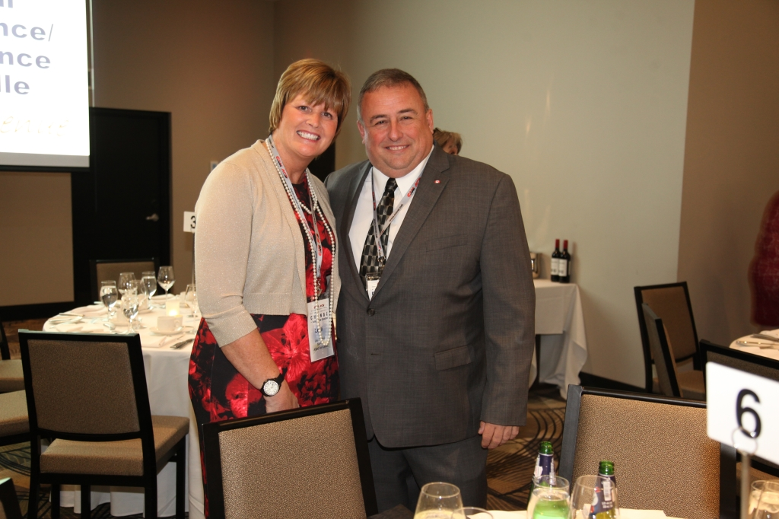
Canadian Association of Movers 2017 Annual Awards Dinner in Montreal, QC

Slide 40
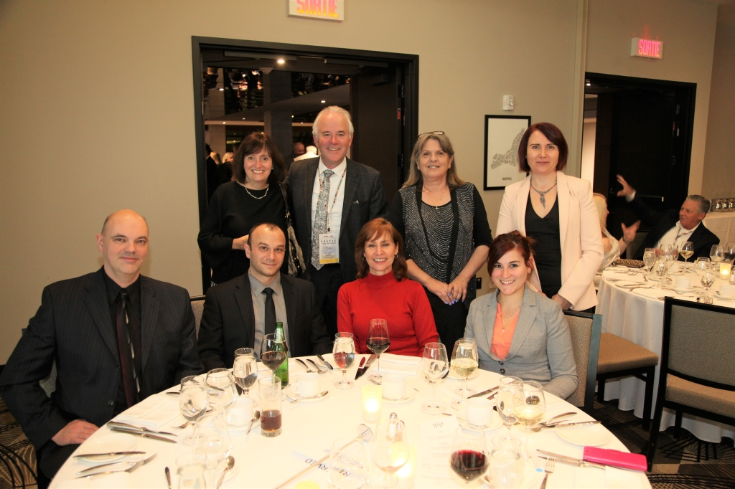
Canadian Association of Movers 2017 Annual Awards Dinner in Montreal, QC

Slide 41
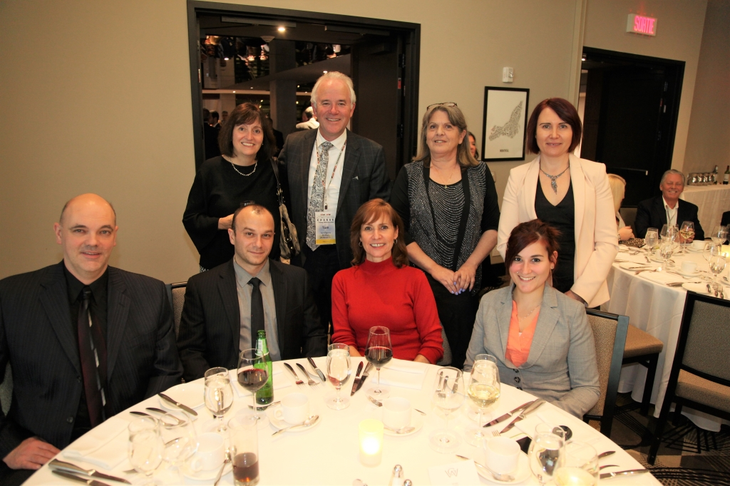
Canadian Association of Movers 2017 Annual Awards Dinner in Montreal, QC

Slide 42
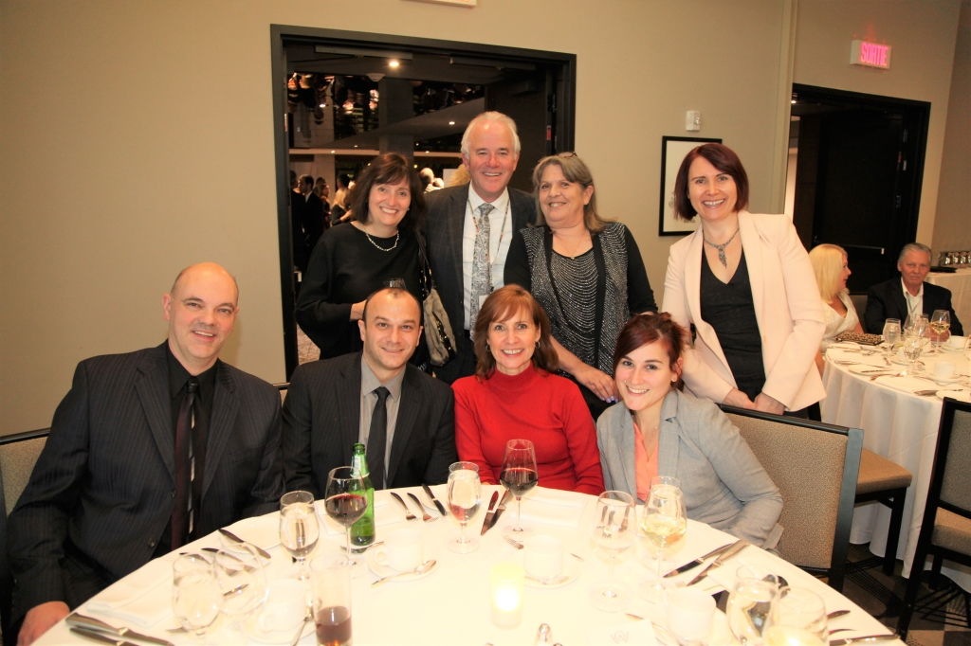
Canadian Association of Movers 2017 Annual Awards Dinner in Montreal, QC

Slide 43
Canadian Association of Movers 2017 Annual Awards Dinner in Montreal, QC

Slide 44
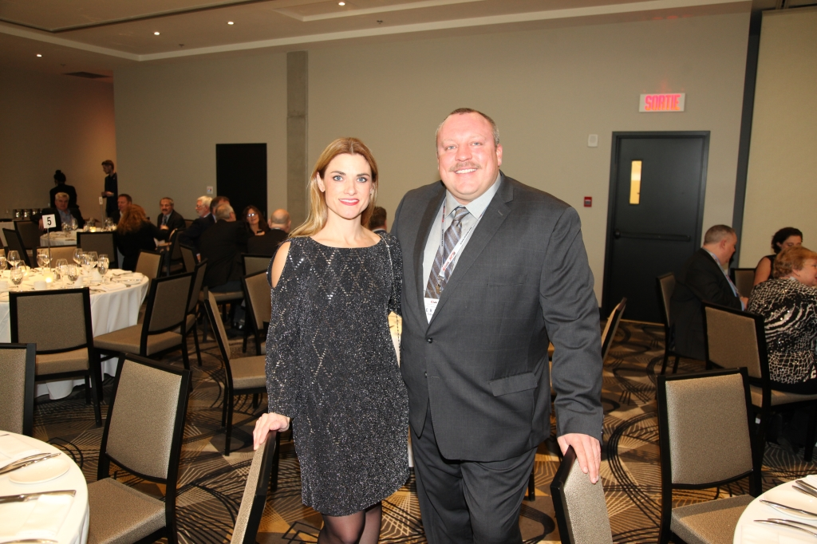
Canadian Association of Movers 2017 Annual Awards Dinner in Montreal, QC

Slide 45
Canadian Association of Movers 2017 Annual Awards Dinner in Montreal, QC

Slide 46
Canadian Association of Movers 2017 Annual Awards Dinner in Montreal, QC

Slide 47
Canadian Association of Movers 2017 Annual Awards Dinner in Montreal, QC

Slide 48
Canadian Association of Movers 2017 Annual Awards Dinner in Montreal, QC

Slide 49
Canadian Association of Movers 2017 Annual Awards Dinner in Montreal, QC

Slide 50
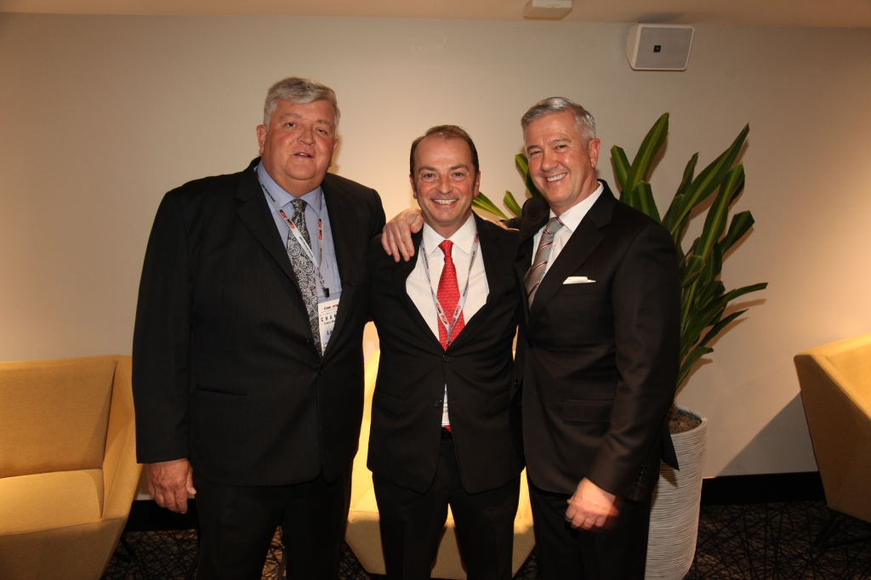
Canadian Association of Movers 2017 Annual Awards Dinner in Montreal, QC

Slide 51
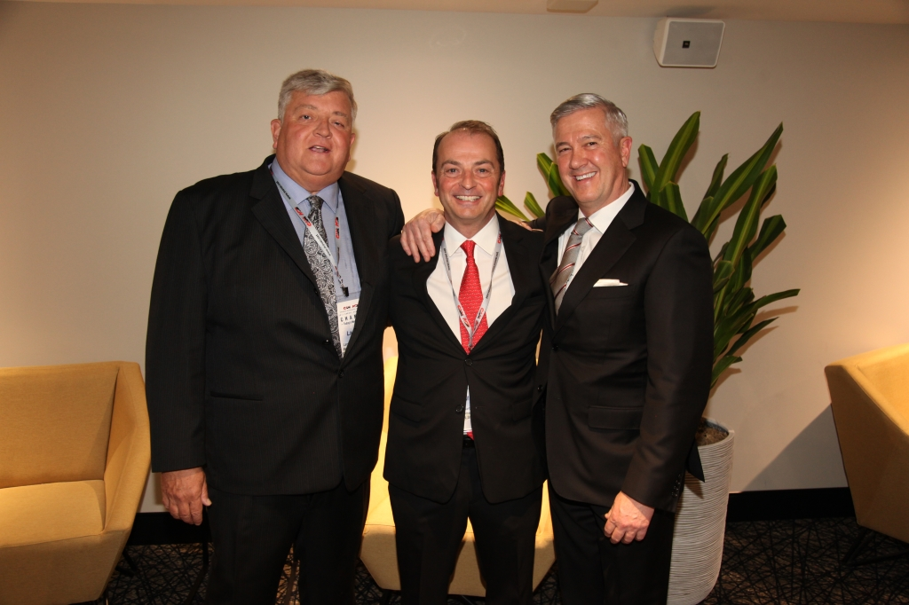
Canadian Association of Movers 2017 Annual Awards Dinner in Montreal, QC

Slide 52
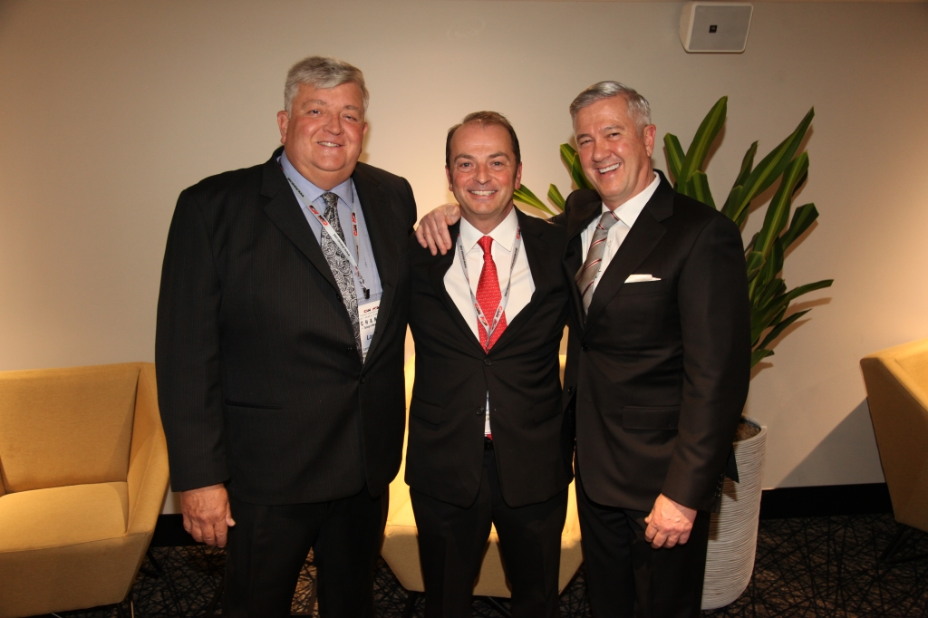
Canadian Association of Movers 2017 Annual Awards Dinner in Montreal, QC

Slide 53
Canadian Association of Movers 2017 Annual Awards Dinner in Montreal, QC

Slide 54
Canadian Association of Movers 2017 Annual Awards Dinner in Montreal, QC

Slide 55
Canadian Association of Movers 2017 Annual Awards Dinner in Montreal, QC

Slide 56
Canadian Association of Movers 2017 Annual Awards Dinner in Montreal, QC

Slide 57
Canadian Association of Movers 2017 Annual Awards Dinner in Montreal, QC

Slide 58
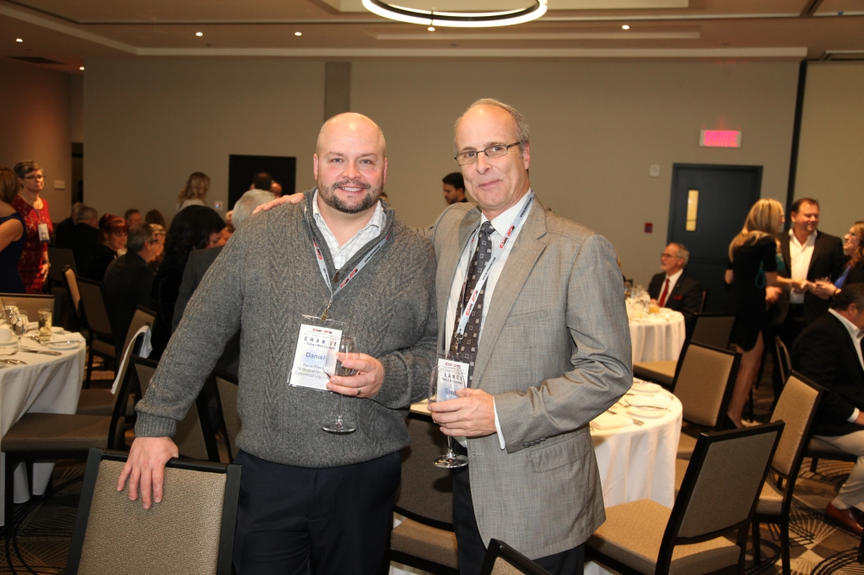
Canadian Association of Movers 2017 Annual Awards Dinner in Montreal, QC

Slide 59
Canadian Association of Movers 2017 Annual Awards Dinner in Montreal, QC

Slide 60
Canadian Association of Movers 2017 Annual Awards Dinner in Montreal, QC

Slide 61
Canadian Association of Movers 2017 Annual Awards Dinner in Montreal, QC

Slide 62
Canadian Association of Movers 2017 Annual Awards Dinner in Montreal, QC

Slide 63
Canadian Association of Movers 2017 Annual Awards Dinner in Montreal, QC

Slide 64
Canadian Association of Movers 2017 Annual Awards Dinner in Montreal, QC

Slide 65
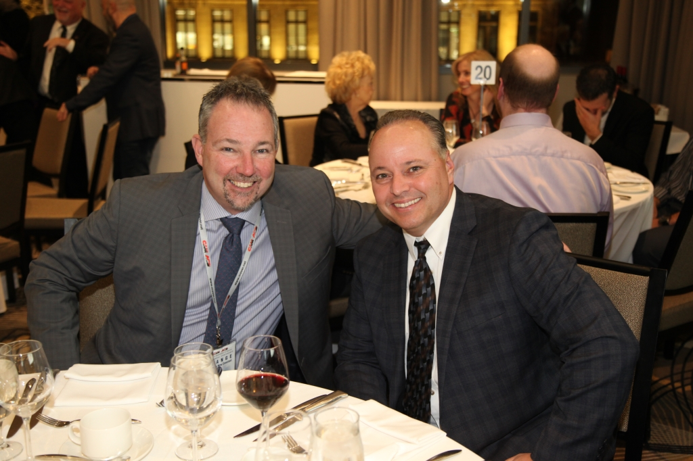
Canadian Association of Movers 2017 Annual Awards Dinner in Montreal, QC

Slide 66
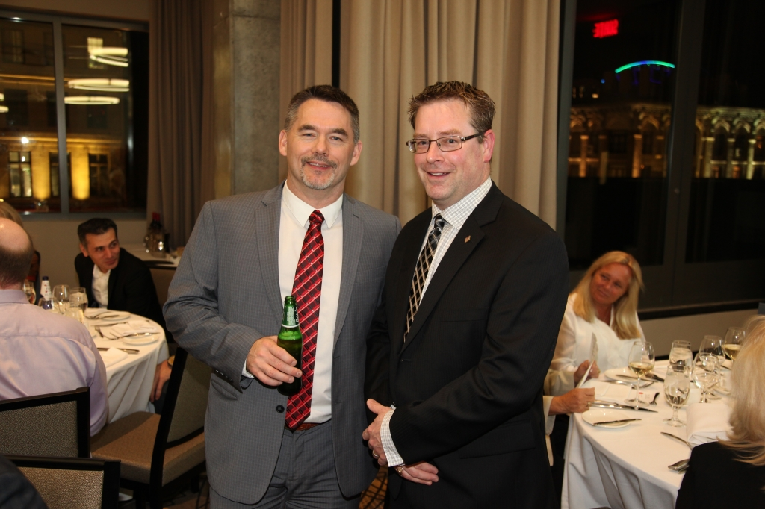
Canadian Association of Movers 2017 Annual Awards Dinner in Montreal, QC

Slide 67
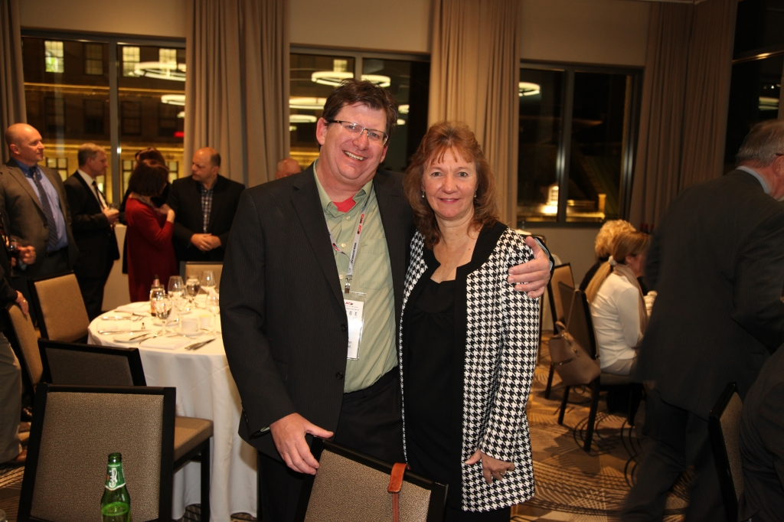
Canadian Association of Movers 2017 Annual Awards Dinner in Montreal, QC

Slide 68
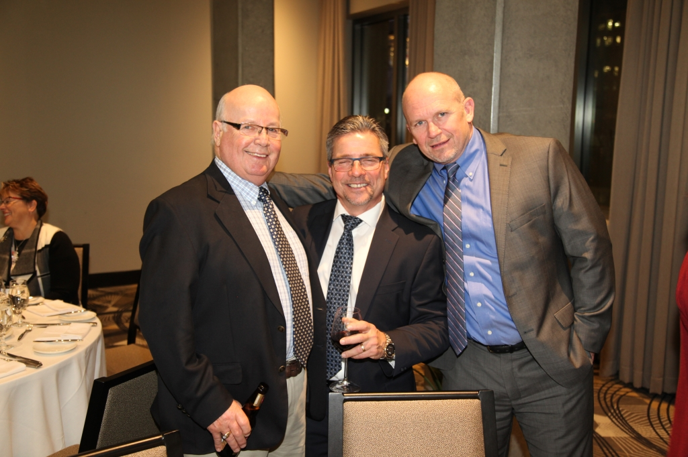
Canadian Association of Movers 2017 Annual Awards Dinner in Montreal, QC

Slide 69
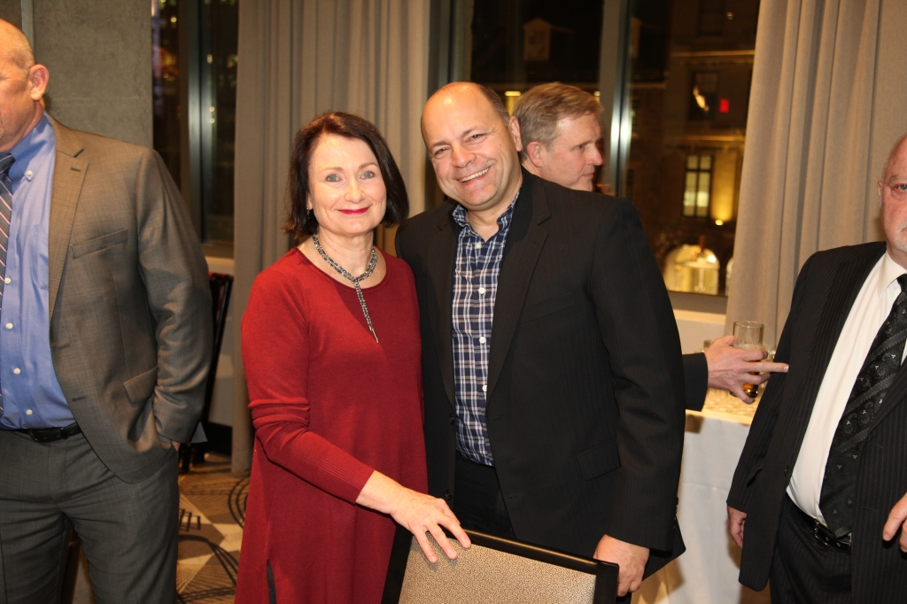
Canadian Association of Movers 2017 Annual Awards Dinner in Montreal, QC

Slide 70
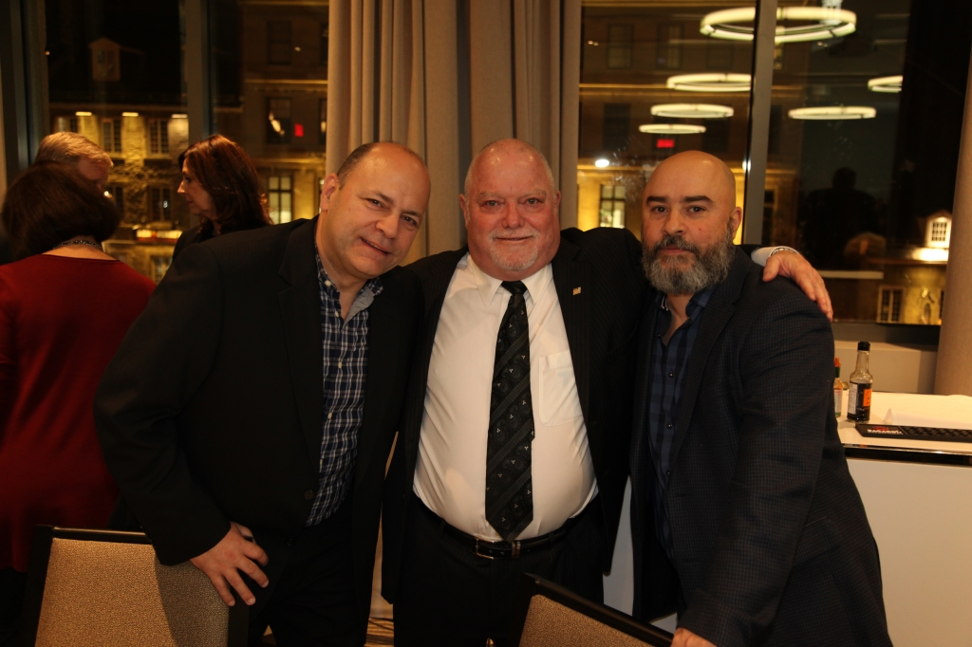
Canadian Association of Movers 2017 Annual Awards Dinner in Montreal, QC

Slide 71
Canadian Association of Movers 2017 Annual Awards Dinner in Montreal, QC

Slide 72
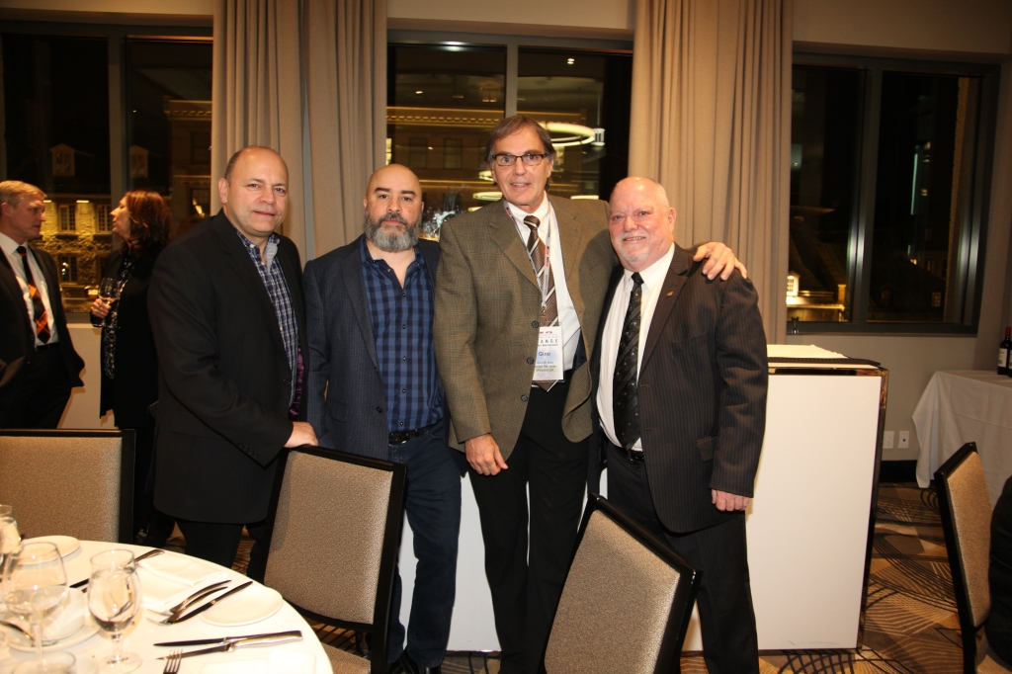
Canadian Association of Movers 2017 Annual Awards Dinner in Montreal, QC

Slide 73
Canadian Association of Movers 2017 Annual Awards Dinner in Montreal, QC

Slide 74
Canadian Association of Movers 2017 Annual Awards Dinner in Montreal, QC

Slide 75
Canadian Association of Movers 2017 Annual Awards Dinner in Montreal, QC

Slide 76
Canadian Association of Movers 2017 Annual Awards Dinner in Montreal, QC

Slide 77
Canadian Association of Movers 2017 Annual Awards Dinner in Montreal, QC

Slide 78
Canadian Association of Movers 2017 Annual Awards Dinner in Montreal, QC

Slide 79
Canadian Association of Movers 2017 Annual Awards Dinner in Montreal, QC

Slide 80
Canadian Association of Movers 2017 Annual Awards Dinner in Montreal, QC

Slide 81
Canadian Association of Movers 2017 Annual Awards Dinner in Montreal, QC

Slide 82
Canadian Association of Movers 2017 Annual Awards Dinner in Montreal, QC

Slide 83
Canadian Association of Movers 2017 Annual Awards Dinner in Montreal, QC

Slide 84
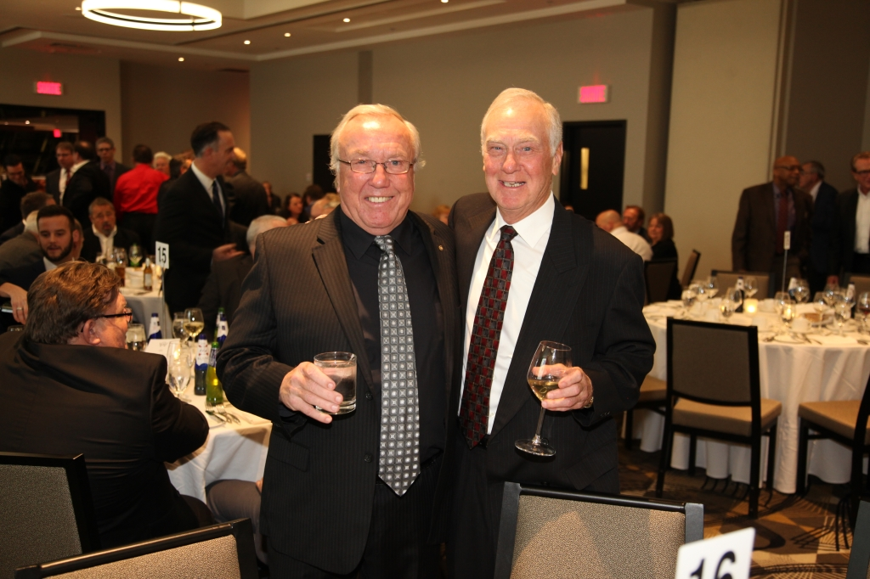
Canadian Association of Movers 2017 Annual Awards Dinner in Montreal, QC

Slide 85
Canadian Association of Movers 2017 Annual Awards Dinner in Montreal, QC

Slide 86
Canadian Association of Movers 2017 Annual Awards Dinner in Montreal, QC

Slide 87
Canadian Association of Movers 2017 Annual Awards Dinner in Montreal, QC

Slide 88
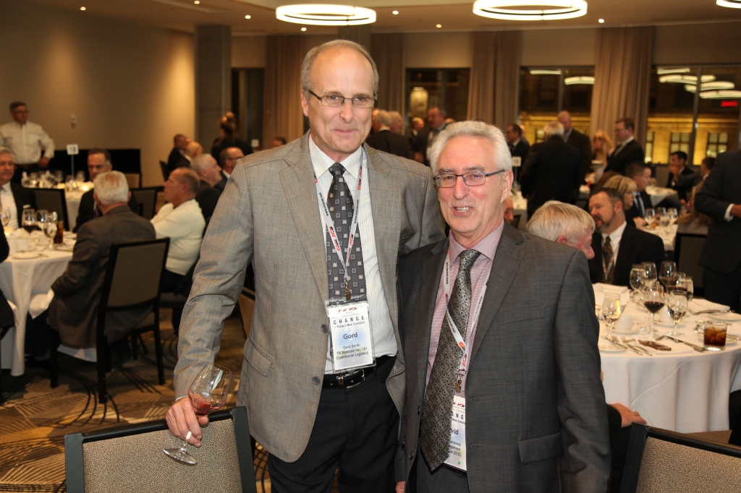
Canadian Association of Movers 2017 Annual Awards Dinner in Montreal, QC

Slide 89
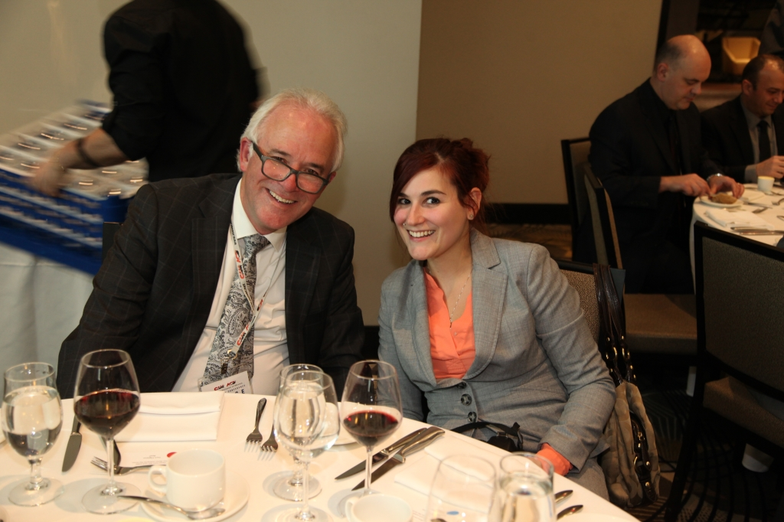
Canadian Association of Movers 2017 Annual Awards Dinner in Montreal, QC

Slide 90
Canadian Association of Movers 2017 Annual Awards Dinner in Montreal, QC

Slide 91
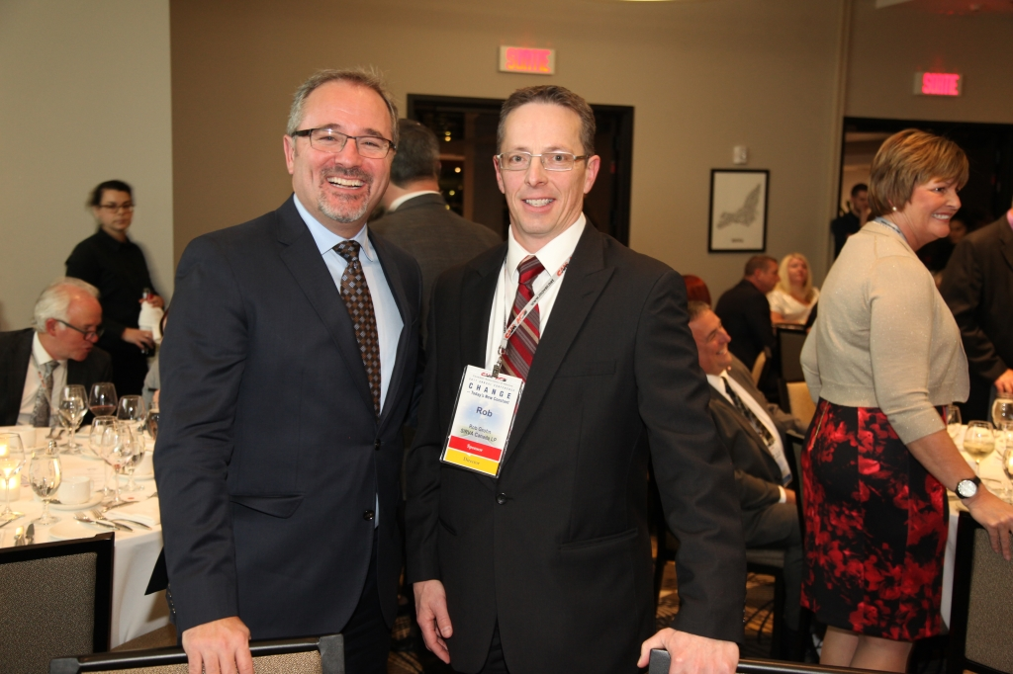
Canadian Association of Movers 2017 Annual Awards Dinner in Montreal, QC

Slide 92
Canadian Association of Movers 2017 Annual Awards Dinner in Montreal, QC

Slide 93
Canadian Association of Movers 2017 Annual Awards Dinner in Montreal, QC

Slide 94
Canadian Association of Movers 2017 Annual Awards Dinner in Montreal, QC

Slide 95
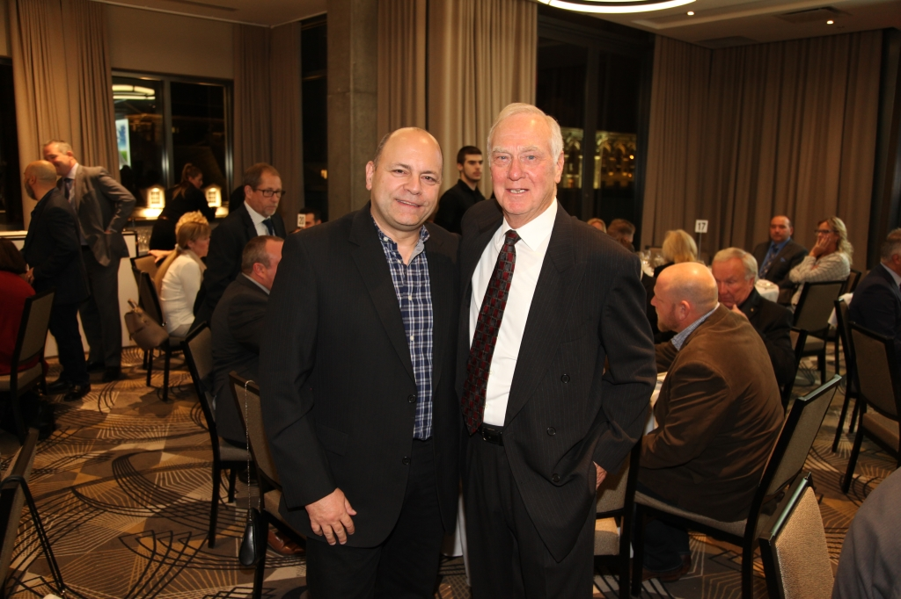
Canadian Association of Movers 2017 Annual Awards Dinner in Montreal, QC

Slide 96
Canadian Association of Movers 2017 Annual Awards Dinner in Montreal, QC

Slide 97
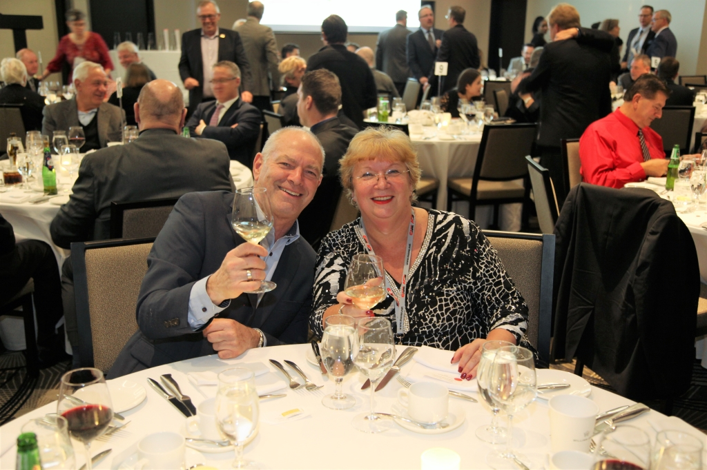
Canadian Association of Movers 2017 Annual Awards Dinner in Montreal, QC

Slide 98
Canadian Association of Movers 2017 Annual Awards Dinner in Montreal, QC

Slide 99
Canadian Association of Movers 2017 Annual Awards Dinner in Montreal, QC

Slide 100
Canadian Association of Movers 2017 Annual Awards Dinner in Montreal, QC

Slide 101
Canadian Association of Movers 2017 Annual Awards Dinner in Montreal, QC

Slide 102
Canadian Association of Movers 2017 Annual Awards Dinner in Montreal, QC

Slide 103
Canadian Association of Movers 2017 Annual Awards Dinner in Montreal, QC

Slide 104
Canadian Association of Movers 2017 Annual Awards Dinner in Montreal, QC

Slide 105
Canadian Association of Movers 2017 Annual Awards Dinner in Montreal, QC

Slide 106
Canadian Association of Movers 2017 Annual Awards Dinner in Montreal, QC

Slide 107
Canadian Association of Movers 2017 Annual Awards Dinner in Montreal, QC

Slide 108
Canadian Association of Movers 2017 Annual Awards Dinner in Montreal, QC

Slide 109
Canadian Association of Movers 2017 Annual Awards Dinner in Montreal, QC

Slide 110
Canadian Association of Movers 2017 Annual Awards Dinner in Montreal, QC

Slide 111
Canadian Association of Movers 2017 Annual Awards Dinner in Montreal, QC

Slide 112
Canadian Association of Movers 2017 Annual Awards Dinner in Montreal, QC

Slide 113
Canadian Association of Movers 2017 Annual Awards Dinner in Montreal, QC

Slide 114
Canadian Association of Movers 2017 Annual Awards Dinner in Montreal, QC

Slide 115
Canadian Association of Movers 2017 Annual Awards Dinner in Montreal, QC

Slide 116
Canadian Association of Movers 2017 Annual Awards Dinner in Montreal, QC

Slide 117
Canadian Association of Movers 2017 Annual Awards Dinner in Montreal, QC

Slide 118
Canadian Association of Movers 2017 Annual Awards Dinner in Montreal, QC

Slide 119
Canadian Association of Movers 2017 Annual Awards Dinner in Montreal, QC

Slide 120
Canadian Association of Movers 2017 Annual Awards Dinner in Montreal, QC

Slide 121
Canadian Association of Movers 2017 Annual Awards Dinner in Montreal, QC

Slide 122
Canadian Association of Movers 2017 Annual Awards Dinner in Montreal, QC

Slide 123
Canadian Association of Movers 2017 Annual Awards Dinner in Montreal, QC

Slide 124
Canadian Association of Movers 2017 Annual Awards Dinner in Montreal, QC

Slide 125
Canadian Association of Movers 2017 Annual Awards Dinner in Montreal, QC

Slide 126
Canadian Association of Movers 2017 Annual Awards Dinner in Montreal, QC

Slide 127
Canadian Association of Movers 2017 Annual Awards Dinner in Montreal, QC

Slide 128
Canadian Association of Movers 2017 Annual Awards Dinner in Montreal, QC

Slide 129
Canadian Association of Movers 2017 Annual Awards Dinner in Montreal, QC

Slide 130
Canadian Association of Movers 2017 Annual Awards Dinner in Montreal, QC

Slide 131
Canadian Association of Movers 2017 Annual Awards Dinner in Montreal, QC

Slide 132
Canadian Association of Movers 2017 Annual Awards Dinner in Montreal, QC

Slide 133
Canadian Association of Movers 2017 Annual Awards Dinner in Montreal, QC

Slide 134
Canadian Association of Movers 2017 Annual Awards Dinner in Montreal, QC

Slide 135
Canadian Association of Movers 2017 Annual Awards Dinner in Montreal, QC

Slide 136
Canadian Association of Movers 2017 Annual Awards Dinner in Montreal, QC

Slide 137
Canadian Association of Movers 2017 Annual Awards Dinner in Montreal, QC

Slide 138
Canadian Association of Movers 2017 Annual Awards Dinner in Montreal, QC

Slide 139
Canadian Association of Movers 2017 Annual Awards Dinner in Montreal, QC

Slide 140
Canadian Association of Movers 2017 Annual Awards Dinner in Montreal, QC

Slide 141
Canadian Association of Movers 2017 Annual Awards Dinner in Montreal, QC

Slide 142
Canadian Association of Movers 2017 Annual Awards Dinner in Montreal, QC

Slide 143
Canadian Association of Movers 2017 Annual Awards Dinner in Montreal, QC

Slide 144
Canadian Association of Movers 2017 Annual Awards Dinner in Montreal, QC

Slide 145
Canadian Association of Movers 2017 Annual Awards Dinner in Montreal, QC

Slide 146
Canadian Association of Movers 2017 Annual Awards Dinner in Montreal, QC

Slide 147
Canadian Association of Movers 2017 Annual Awards Dinner in Montreal, QC

Slide 148
Canadian Association of Movers 2017 Annual Awards Dinner in Montreal, QC

Slide 149
Canadian Association of Movers 2017 Annual Awards Dinner in Montreal, QC

Slide 150
Canadian Association of Movers 2017 Annual Awards Dinner in Montreal, QC

Slide 151
Canadian Association of Movers 2017 Annual Awards Dinner in Montreal, QC

Slide 152
Canadian Association of Movers 2017 Annual Awards Dinner in Montreal, QC

Slide 153
Canadian Association of Movers 2017 Annual Awards Dinner in Montreal, QC

Slide 154
Canadian Association of Movers 2017 Annual Awards Dinner in Montreal, QC

Slide 155
Canadian Association of Movers 2017 Annual Awards Dinner in Montreal, QC

Slide 156
Canadian Association of Movers 2017 Annual Awards Dinner in Montreal, QC

Slide 157
Canadian Association of Movers 2017 Annual Awards Dinner in Montreal, QC

Slide 158
Canadian Association of Movers 2017 Annual Awards Dinner in Montreal, QC

Slide 159
Canadian Association of Movers 2017 Annual Awards Dinner in Montreal, QC

Slide 160
Canadian Association of Movers 2017 Annual Awards Dinner in Montreal, QC

Slide 161
Canadian Association of Movers 2017 Annual Awards Dinner in Montreal, QC

Slide 162
Canadian Association of Movers 2017 Annual Awards Dinner in Montreal, QC

Slide 163
Canadian Association of Movers 2017 Annual Awards Dinner in Montreal, QC

Slide 164
Canadian Association of Movers 2017 Annual Awards Dinner in Montreal, QC

Slide 165
Canadian Association of Movers 2017 Annual Awards Dinner in Montreal, QC

Slide 166
Canadian Association of Movers 2017 Annual Awards Dinner in Montreal, QC

Slide 167
Canadian Association of Movers 2017 Annual Awards Dinner in Montreal, QC

Slide 168
Canadian Association of Movers 2017 Annual Awards Dinner in Montreal, QC

Slide 169
Canadian Association of Movers 2017 Annual Awards Dinner in Montreal, QC

Slide 170
Canadian Association of Movers 2017 Annual Awards Dinner in Montreal, QC

Slide 171
Canadian Association of Movers 2017 Annual Awards Dinner in Montreal, QC

Slide 172
Canadian Association of Movers 2017 Annual Awards Dinner in Montreal, QC

Slide 173
Canadian Association of Movers 2017 Annual Awards Dinner in Montreal, QC

Slide 174
Canadian Association of Movers 2017 Annual Awards Dinner in Montreal, QC

Slide 175
Canadian Association of Movers 2017 Annual Awards Dinner in Montreal, QC

Slide 176
Canadian Association of Movers 2017 Annual Awards Dinner in Montreal, QC

Slide 177
Canadian Association of Movers 2017 Annual Awards Dinner in Montreal, QC

Slide 178
Canadian Association of Movers 2017 Annual Awards Dinner in Montreal, QC

Slide 179
Canadian Association of Movers 2017 Annual Awards Dinner in Montreal, QC

Slide 180
Canadian Association of Movers 2017 Annual Awards Dinner in Montreal, QC

Slide 181
Canadian Association of Movers 2017 Annual Awards Dinner in Montreal, QC

Slide 182
Canadian Association of Movers 2017 Annual Awards Dinner in Montreal, QC

Slide 183
Canadian Association of Movers 2017 Annual Awards Dinner in Montreal, QC

Slide 184
Canadian Association of Movers 2017 Annual Awards Dinner in Montreal, QC

Slide 185
Canadian Association of Movers 2017 Annual Awards Dinner in Montreal, QC

Slide 186
Canadian Association of Movers 2017 Annual Awards Dinner in Montreal, QC

Slide 187
Canadian Association of Movers 2017 Annual Awards Dinner in Montreal, QC

Slide 188
Canadian Association of Movers 2017 Annual Awards Dinner in Montreal, QC

Slide 189
Canadian Association of Movers 2017 Annual Awards Dinner in Montreal, QC

Slide 190
Canadian Association of Movers 2017 Annual Awards Dinner in Montreal, QC

Slide 191
Canadian Association of Movers 2017 Annual Awards Dinner in Montreal, QC

Slide 192
Canadian Association of Movers 2017 Annual Awards Dinner in Montreal, QC

Slide 193
Canadian Association of Movers 2017 Annual Awards Dinner in Montreal, QC

Slide 194
Canadian Association of Movers 2017 Annual Awards Dinner in Montreal, QC

Slide 195
Canadian Association of Movers 2017 Annual Awards Dinner in Montreal, QC

Slide 196
Canadian Association of Movers 2017 Annual Awards Dinner in Montreal, QC

Slide 197
Canadian Association of Movers 2017 Annual Awards Dinner in Montreal, QC

Slide 198
Canadian Association of Movers 2017 Annual Awards Dinner in Montreal, QC

Slide 199
Canadian Association of Movers 2017 Annual Awards Dinner in Montreal, QC

Slide 200
Canadian Association of Movers 2017 Annual Awards Dinner in Montreal, QC

Slide 201
Canadian Association of Movers 2017 Annual Awards Dinner in Montreal, QC

Slide 202
Canadian Association of Movers 2017 Annual Awards Dinner in Montreal, QC

Slide 203
Canadian Association of Movers 2017 Annual Awards Dinner in Montreal, QC

Slide 204
Canadian Association of Movers 2017 Annual Awards Dinner in Montreal, QC

Slide 205
Canadian Association of Movers 2017 Annual Awards Dinner in Montreal, QC

Slide 206
Canadian Association of Movers 2017 Annual Awards Dinner in Montreal, QC

Slide 207
Canadian Association of Movers 2017 Annual Awards Dinner in Montreal, QC

Slide 208
Canadian Association of Movers 2017 Annual Awards Dinner in Montreal, QC

Slide 209
Canadian Association of Movers 2017 Annual Awards Dinner in Montreal, QC

Slide 210
Canadian Association of Movers 2017 Annual Awards Dinner in Montreal, QC

Slide 211
Canadian Association of Movers 2017 Annual Awards Dinner in Montreal, QC

Slide 212
Canadian Association of Movers 2017 Annual Awards Dinner in Montreal, QC

Slide 213
Canadian Association of Movers 2017 Annual Awards Dinner in Montreal, QC

Slide 214
Canadian Association of Movers 2017 Annual Awards Dinner in Montreal, QC

Slide 215
Canadian Association of Movers 2017 Annual Awards Dinner in Montreal, QC

Slide 216
Canadian Association of Movers 2017 Annual Awards Dinner in Montreal, QC

Slide 217
Canadian Association of Movers 2017 Annual Awards Dinner in Montreal, QC

Slide 218
Canadian Association of Movers 2017 Annual Awards Dinner in Montreal, QC

Slide 219
Canadian Association of Movers 2017 Annual Awards Dinner in Montreal, QC

Slide 220
Canadian Association of Movers 2017 Annual Awards Dinner in Montreal, QC

Slide 221
Canadian Association of Movers 2017 Annual Awards Dinner in Montreal, QC

Slide 222
Canadian Association of Movers 2017 Annual Awards Dinner in Montreal, QC

Slide 223
Canadian Association of Movers 2017 Annual Awards Dinner in Montreal, QC

Slide 224
Canadian Association of Movers 2017 Annual Awards Dinner in Montreal, QC

Slide 225
Canadian Association of Movers 2017 Annual Awards Dinner in Montreal, QC

Slide 226
Canadian Association of Movers 2017 Annual Awards Dinner in Montreal, QC

Slide 227
Canadian Association of Movers 2017 Annual Awards Dinner in Montreal, QC

Slide 228
Canadian Association of Movers 2017 Annual Awards Dinner in Montreal, QC

Slide 229
Canadian Association of Movers 2017 Annual Awards Dinner in Montreal, QC

Slide 230
Canadian Association of Movers 2017 Annual Awards Dinner in Montreal, QC

