Slide 1
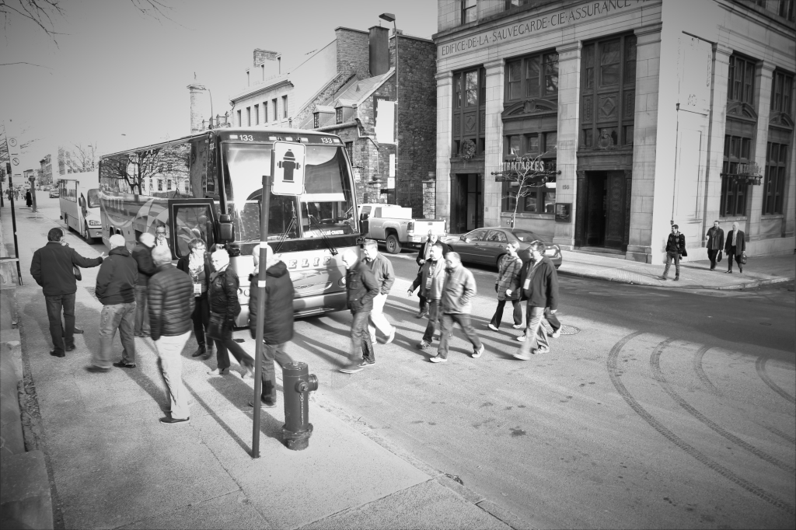
Canadian Association of Movers 2017 Port Tour in Montreal, QC

Slide 2
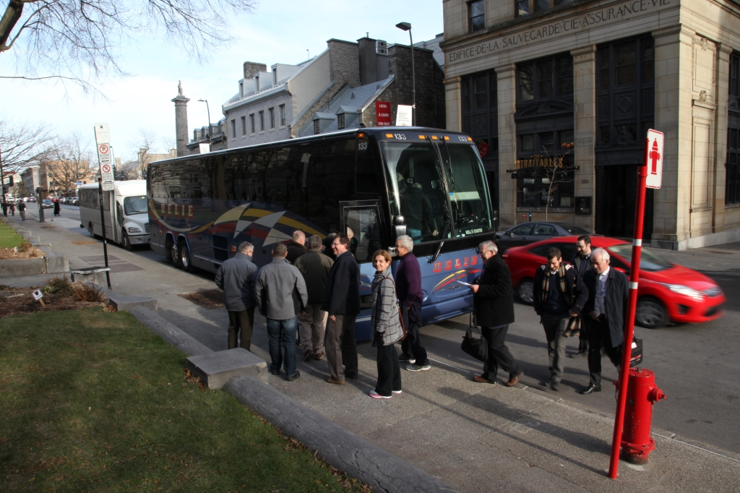
Canadian Association of Movers 2017 Port Tour in Montreal, QC

Slide 3
Canadian Association of Movers 2017 Port Tour in Montreal, QC

Slide 4
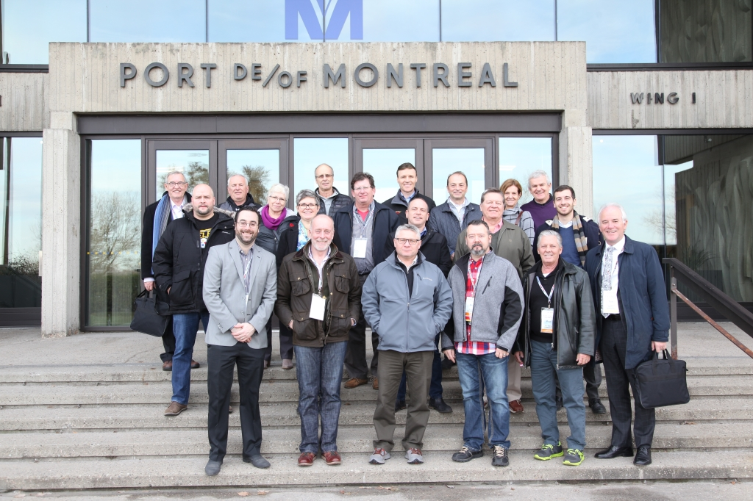
Canadian Association of Movers 2017 Port Tour in Montreal, QC

Slide 5
Canadian Association of Movers 2017 Port Tour in Montreal, QC

Slide 6
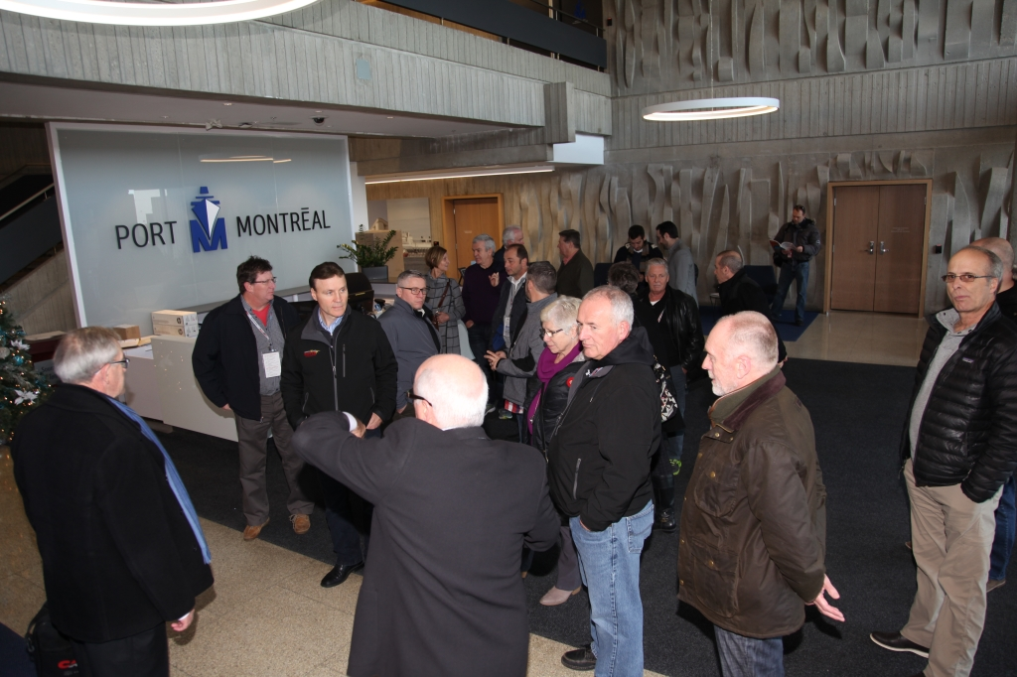
Canadian Association of Movers 2017 Port Tour in Montreal, QC

Slide 7
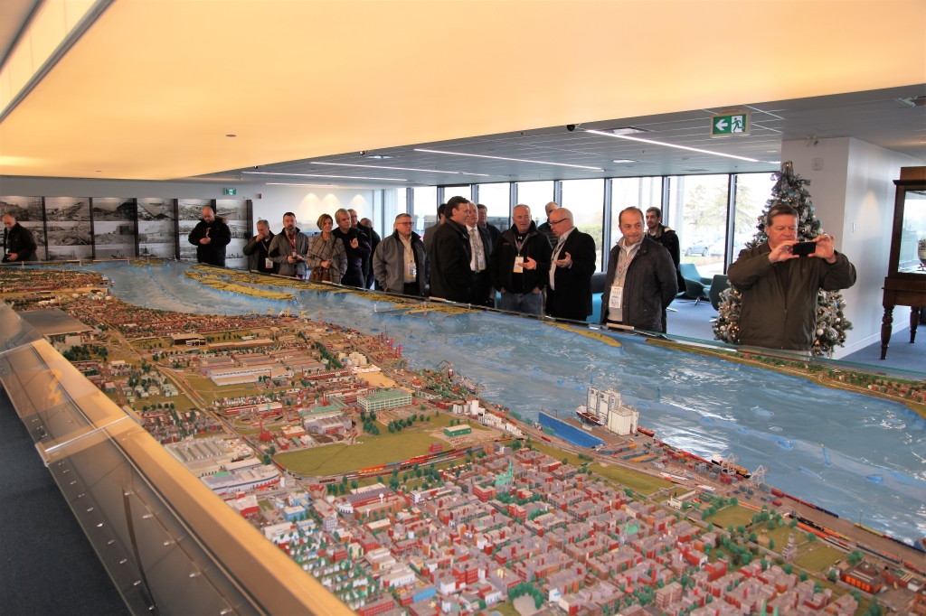
Canadian Association of Movers 2017 Port Tour in Montreal, QC

Slide 8
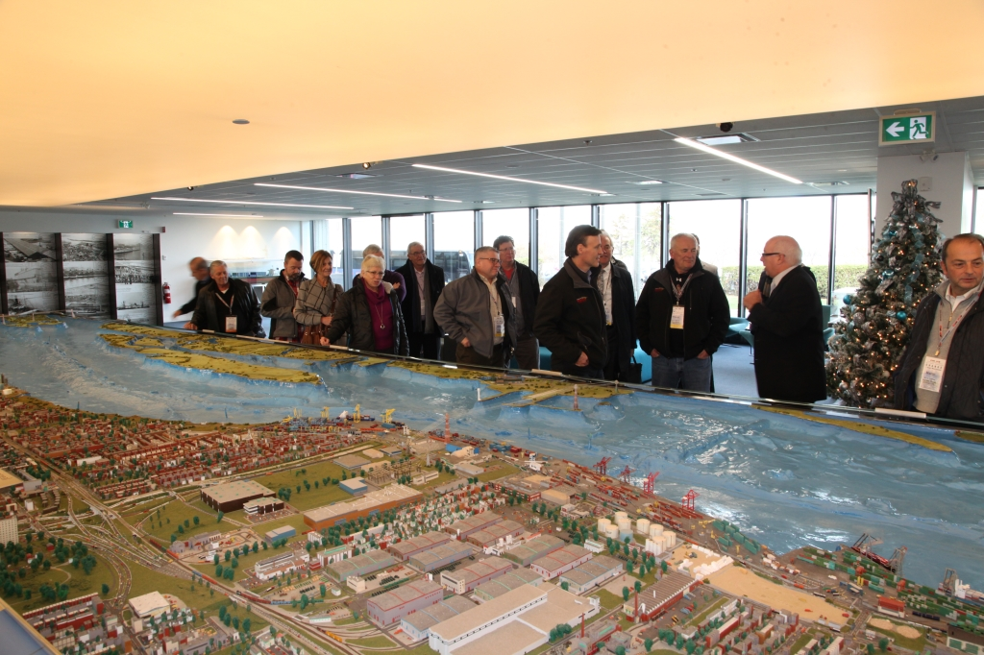
Canadian Association of Movers 2017 Port Tour in Montreal, QC

Slide 9
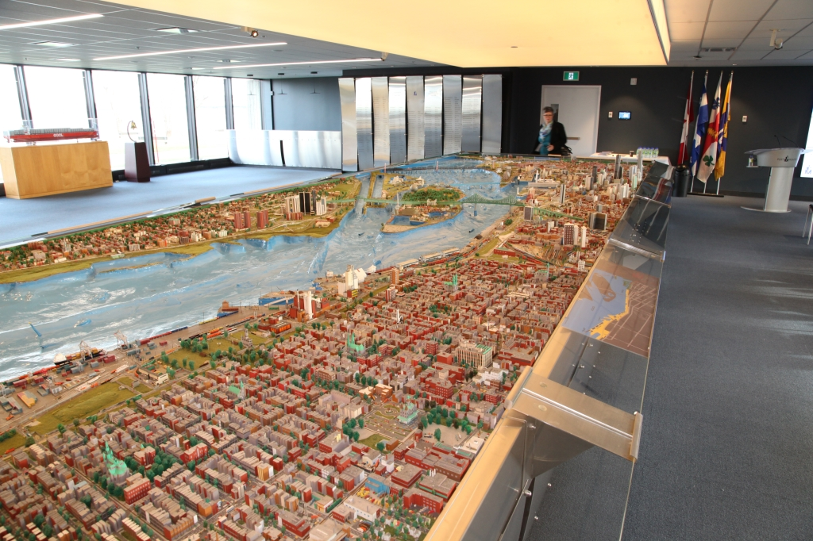
Canadian Association of Movers 2017 Port Tour in Montreal, QC

Slide 10
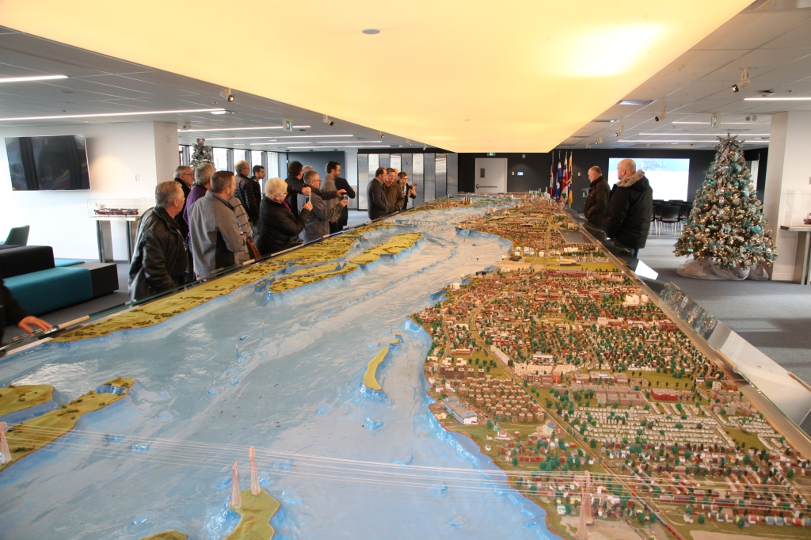
Canadian Association of Movers 2017 Port Tour in Montreal, QC

Slide 11
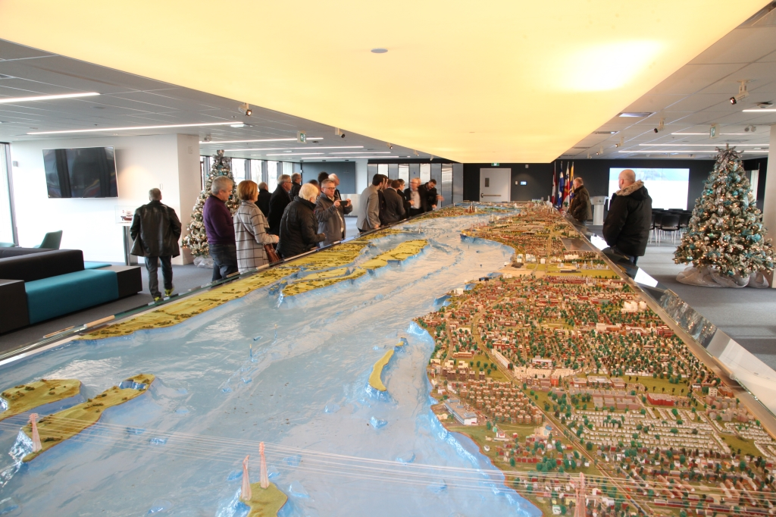
Canadian Association of Movers 2017 Port Tour in Montreal, QC

Slide 12
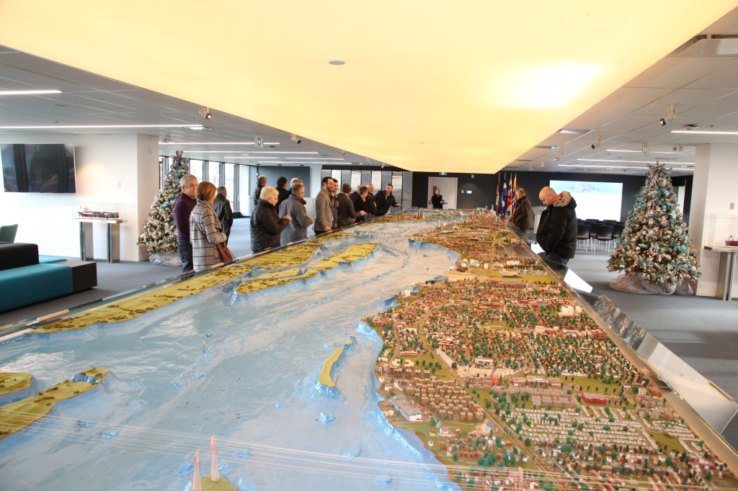
Canadian Association of Movers 2017 Port Tour in Montreal, QC

Slide 13
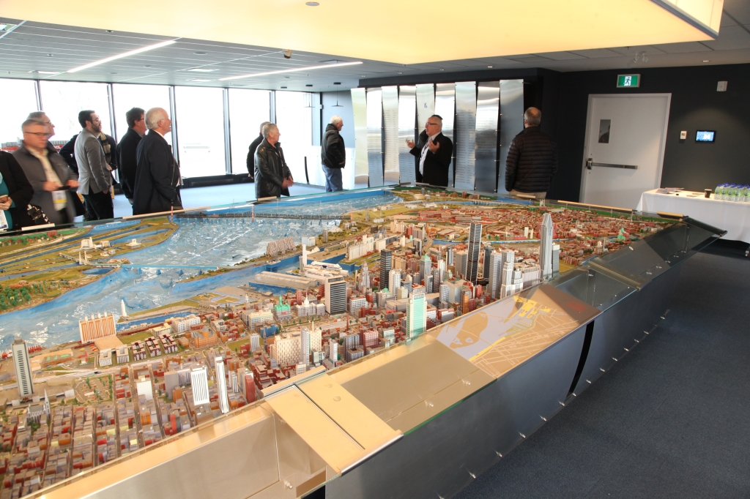
Canadian Association of Movers 2017 Port Tour in Montreal, QC

Slide 14
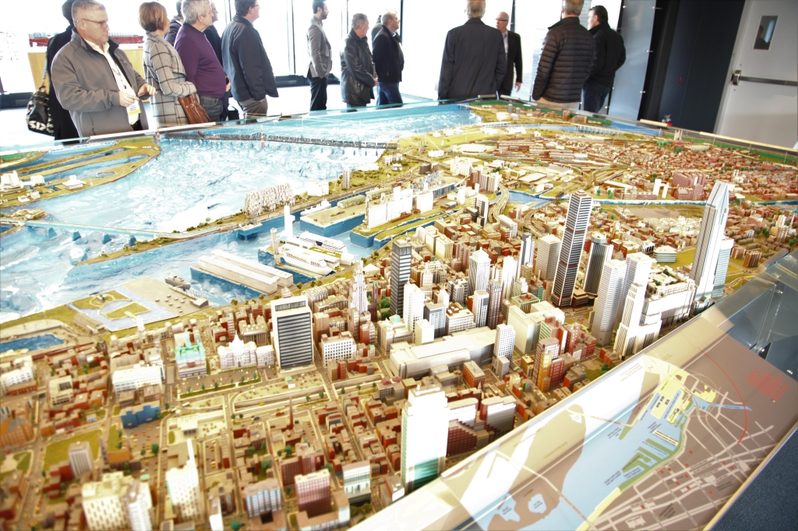
Canadian Association of Movers 2017 Port Tour in Montreal, QC

Slide 15
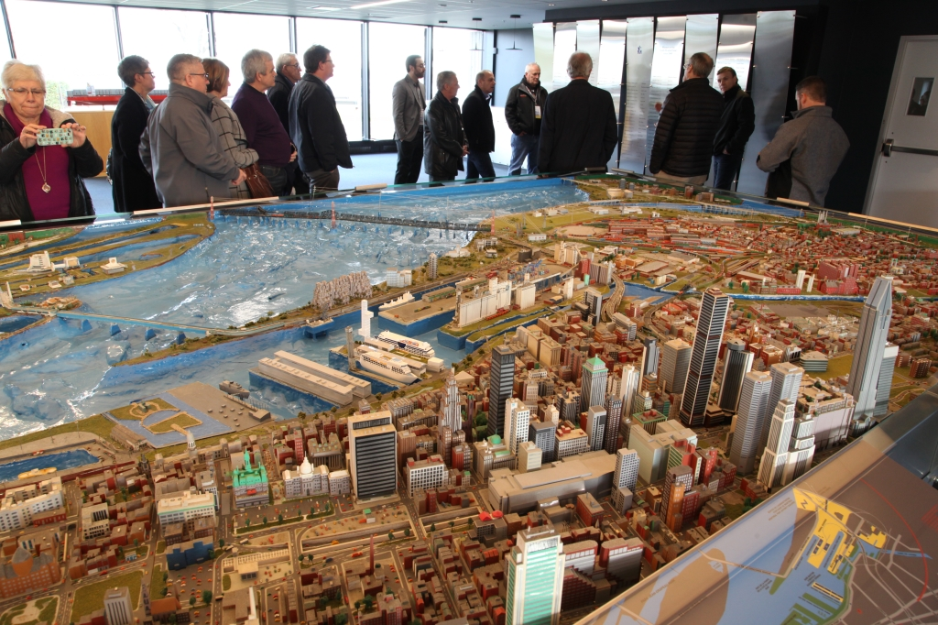
Canadian Association of Movers 2017 Port Tour in Montreal, QC

Slide 16
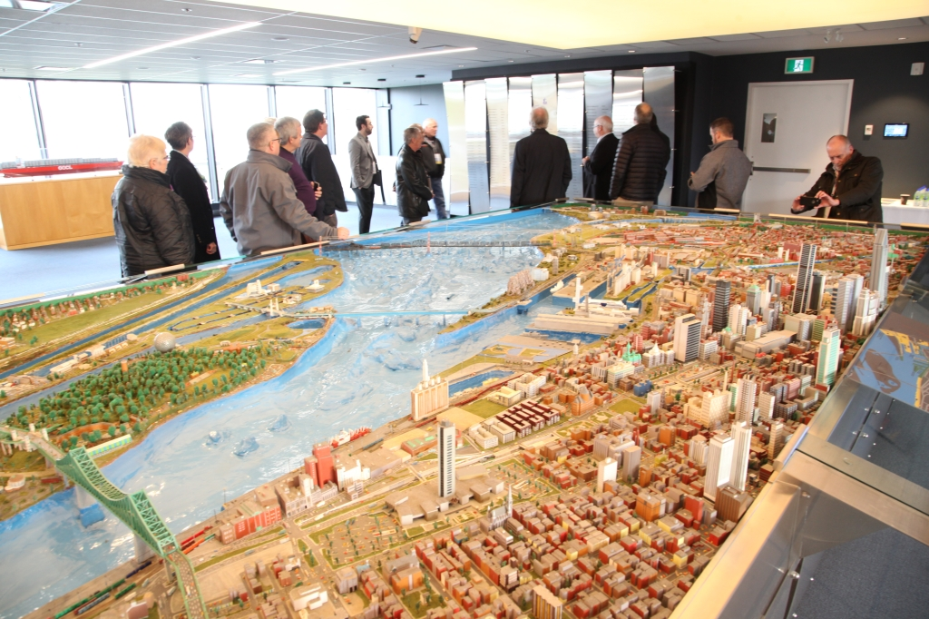
Canadian Association of Movers 2017 Port Tour in Montreal, QC

Slide 17
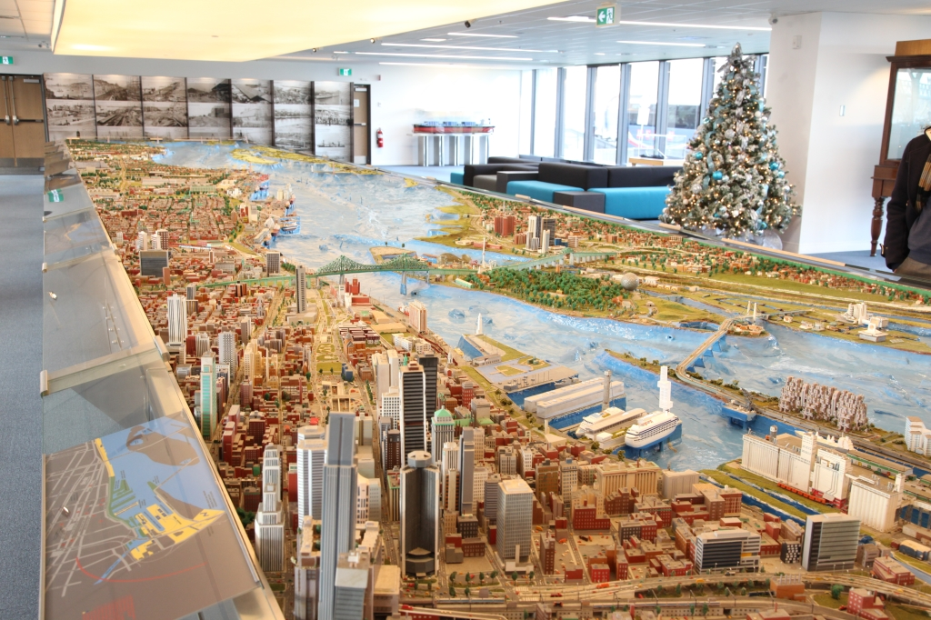
Canadian Association of Movers 2017 Port Tour in Montreal, QC

Slide 18
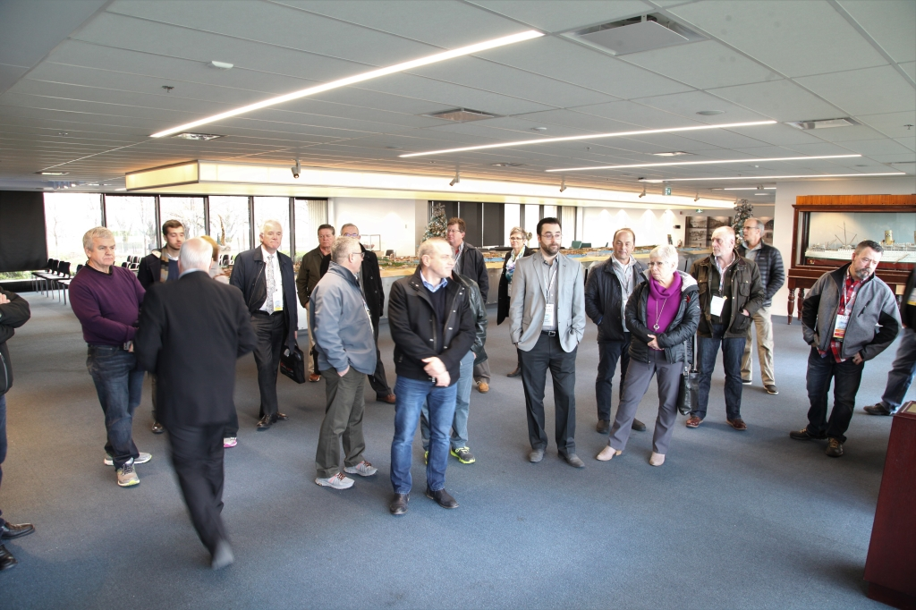
Canadian Association of Movers 2017 Port Tour in Montreal, QC

Slide 19
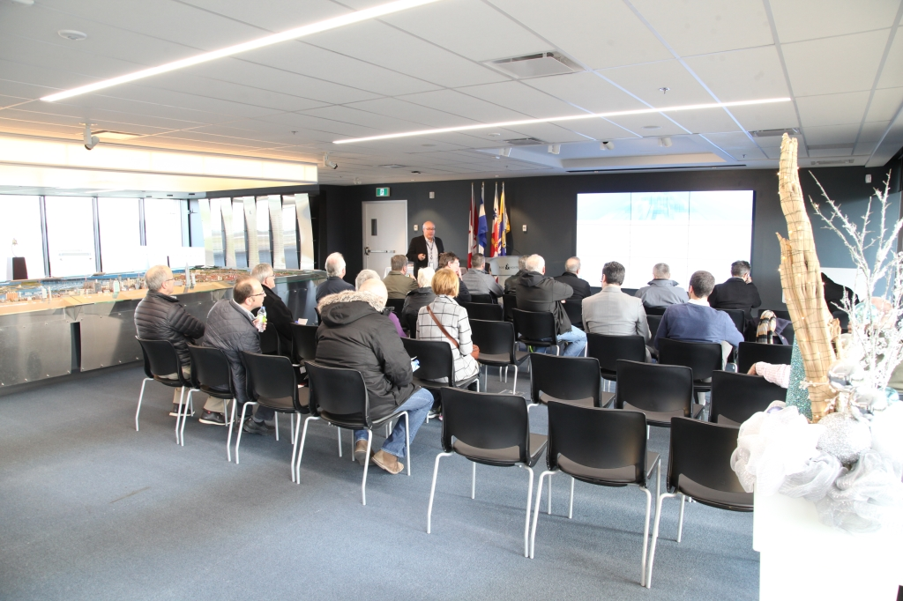
Canadian Association of Movers 2017 Port Tour in Montreal, QC

Slide 20
Canadian Association of Movers 2017 Port Tour in Montreal, QC

Slide 21
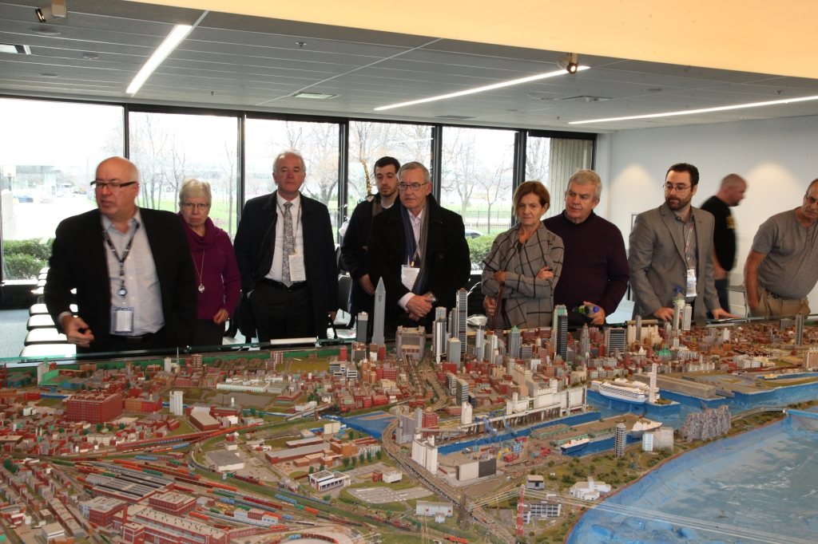
Canadian Association of Movers 2017 Port Tour in Montreal, QC

Slide 22
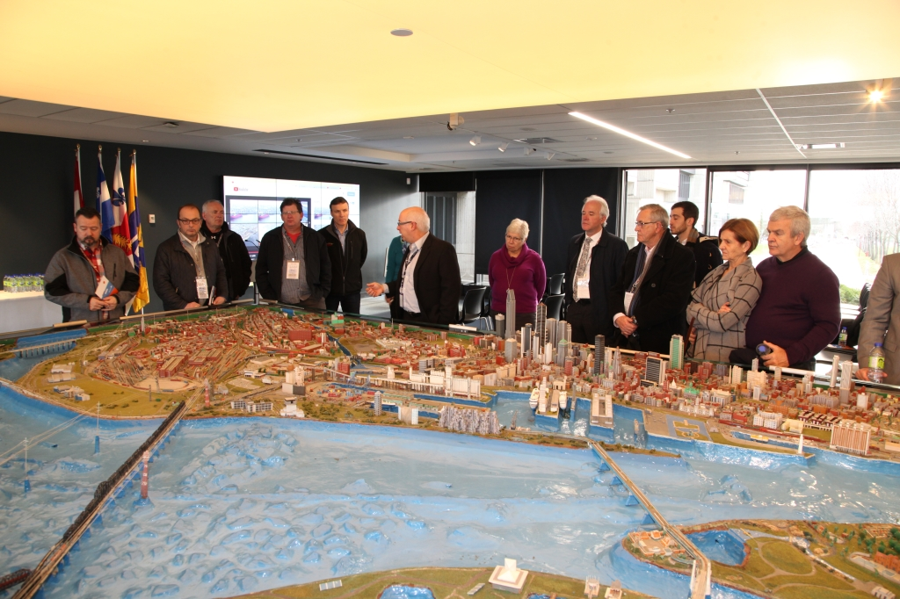
Canadian Association of Movers 2017 Port Tour in Montreal, QC

Slide 23
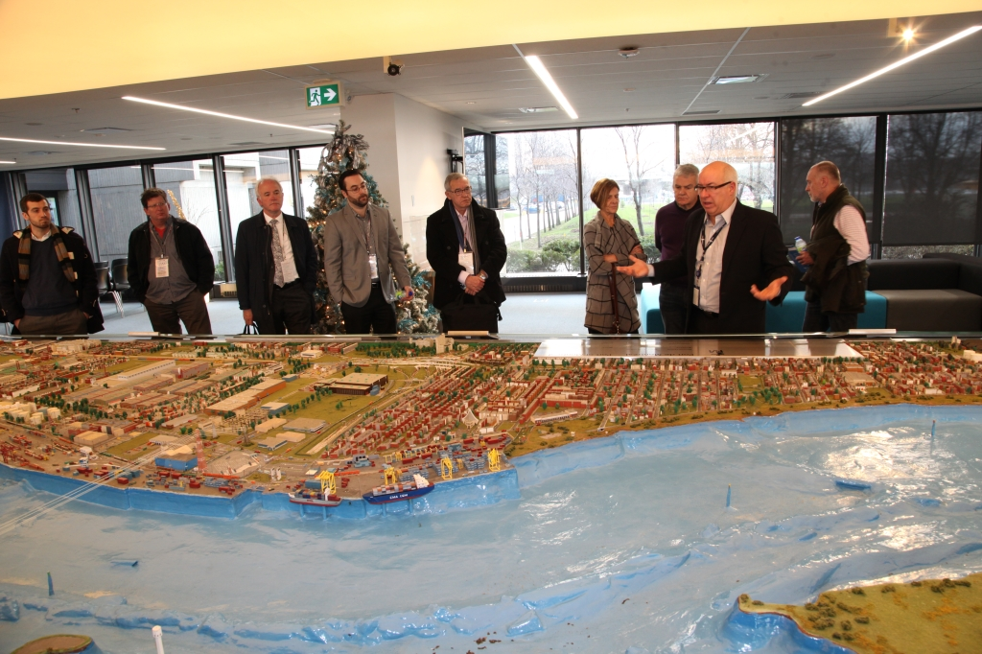
Canadian Association of Movers 2017 Port Tour in Montreal, QC

Slide 24
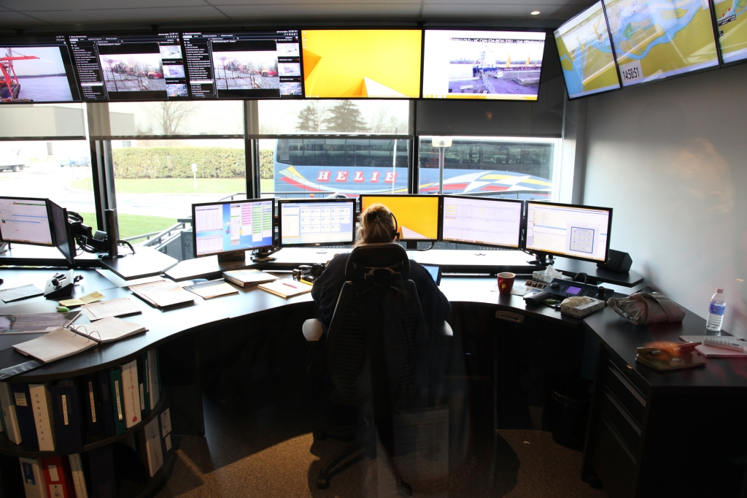
Canadian Association of Movers 2017 Port Tour in Montreal, QC

Slide 25
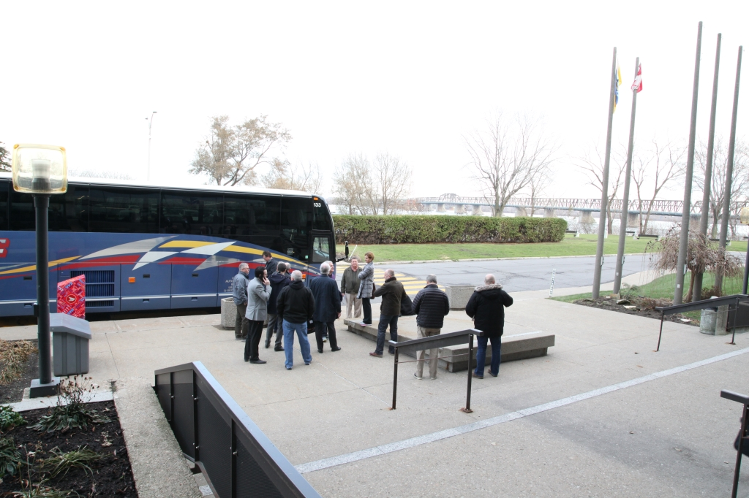
Canadian Association of Movers 2017 Port Tour in Montreal, QC

Slide 26
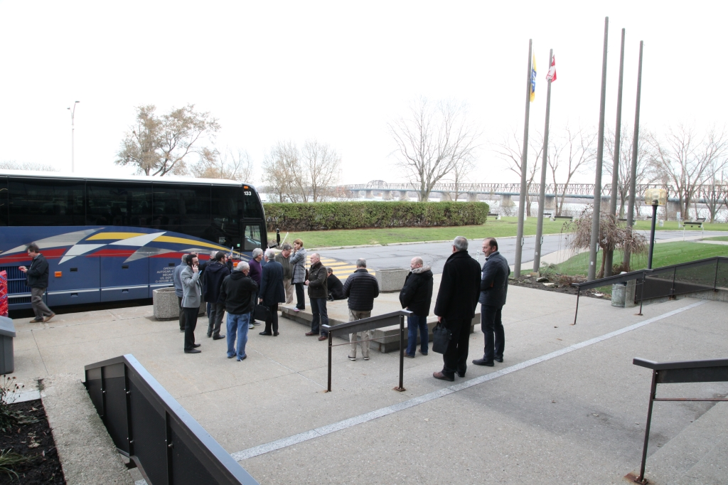
Canadian Association of Movers 2017 Port Tour in Montreal, QC

