Slide 1
Canadian Association
of Movers
2018 Annual Conference

Slide 2
Canadian Association
of Movers
2018 Annual Conference

Slide 3
Canadian Association
of Movers
2018 Annual Conference

Slide 4
Canadian Association
of Movers
2018 Annual Conference

Slide 5
Canadian Association
of Movers
2018 Annual Conference

Slide 6
Canadian Association
of Movers
2018 Annual Conference

Slide 7
Canadian Association
of Movers
2018 Annual Conference

Slide 8
Canadian Association
of Movers
2018 Annual Conference

Slide 9
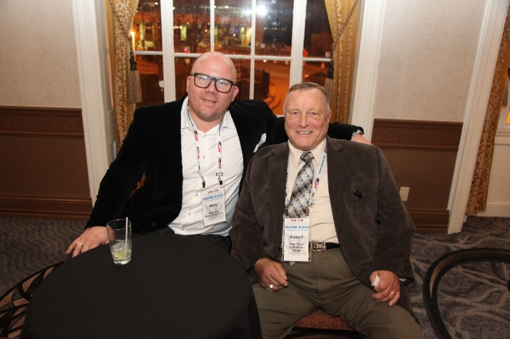
Canadian Association
of Movers
2018 Annual Conference

Slide 10
Canadian Association
of Movers
2018 Annual Conference

Slide 11
Canadian Association
of Movers
2018 Annual Conference

Slide 12
Canadian Association
of Movers
2018 Annual Conference

Slide 13
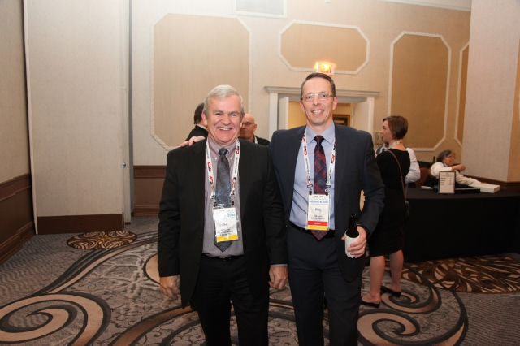
Canadian Association
of Movers
2018 Annual Conference

Slide 14
Canadian Association
of Movers
2018 Annual Conference

Slide 15
Canadian Association
of Movers
2018 Annual Conference

Slide 16
Canadian Association
of Movers
2018 Annual Conference

Slide 17
Canadian Association
of Movers
2018 Annual Conference

Slide 18
Canadian Association
of Movers
2018 Annual Conference

Slide 19
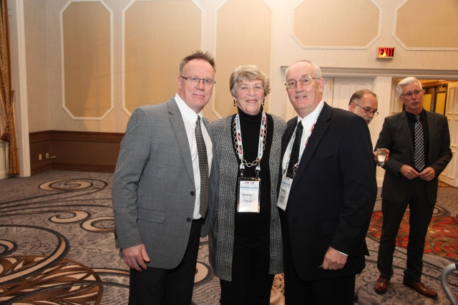
Canadian Association
of Movers
2018 Annual Conference

Slide 20
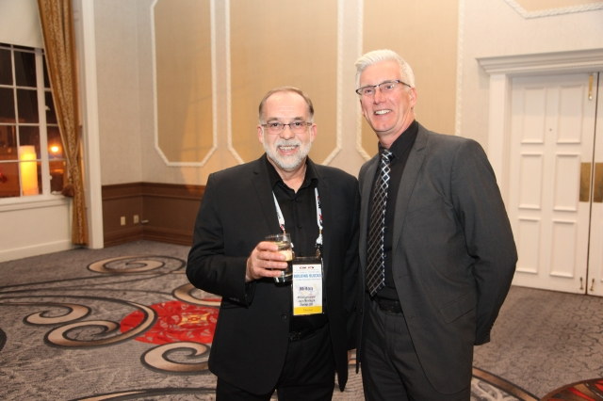
Canadian Association
of Movers
2018 Annual Conference

Slide 21
Canadian Association
of Movers
2018 Annual Conference

Slide 22
Canadian Association
of Movers
2018 Annual Conference

Slide 23
Canadian Association
of Movers
2018 Annual Conference

Slide 24
Canadian Association
of Movers
2018 Annual Conference

Slide 25
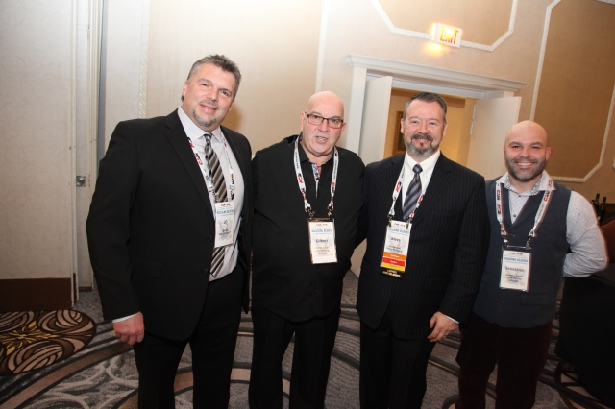
Canadian Association
of Movers
2018 Annual Conference

Slide 26
Canadian Association
of Movers
2018 Annual Conference

Slide 27
Canadian Association
of Movers
2018 Annual Conference

Slide 28
Canadian Association
of Movers
2018 Annual Conference

Slide 29
Canadian Association
of Movers
2018 Annual Conference

Slide 30
Canadian Association
of Movers
2018 Annual Conference

Slide 31
Canadian Association
of Movers
2018 Annual Conference

Slide 32
Canadian Association
of Movers
2018 Annual Conference

Slide 33
Canadian Association
of Movers
2018 Annual Conference

Slide 34
Canadian Association
of Movers
2018 Annual Conference

Slide 35
Canadian Association
of Movers
2018 Annual Conference

Slide 36
Canadian Association
of Movers
2018 Annual Conference

Slide 37
Canadian Association
of Movers
2018 Annual Conference

Slide 38
Canadian Association
of Movers
2018 Annual Conference

Slide 39
Canadian Association
of Movers
2018 Annual Conference

Slide 40
Canadian Association
of Movers
2018 Annual Conference

Slide 41
Canadian Association
of Movers
2018 Annual Conference

Slide 42
Canadian Association
of Movers
2018 Annual Conference

Slide 43
Canadian Association
of Movers
2018 Annual Conference

Slide 44
Canadian Association
of Movers
2018 Annual Conference

Slide 45
Canadian Association
of Movers
2018 Annual Conference

Slide 46
Canadian Association
of Movers
2018 Annual Conference

Slide 47
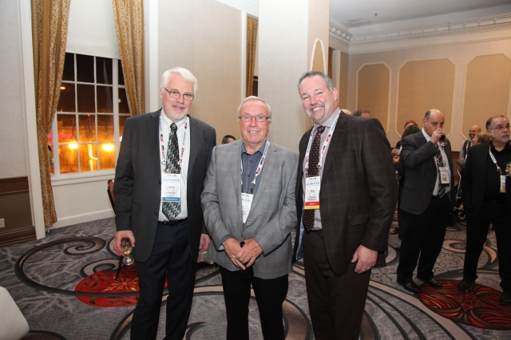
Canadian Association
of Movers
2018 Annual Conference

Slide 48
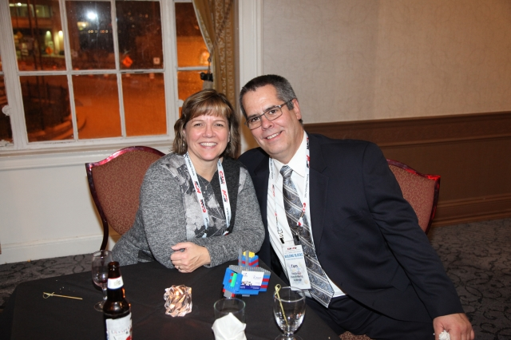
Canadian Association
of Movers
2018 Annual Conference

Slide 49
Canadian Association
of Movers
2018 Annual Conference

Slide 50
Canadian Association
of Movers
2018 Annual Conference

Slide 51
Canadian Association
of Movers
2018 Annual Conference

Slide 52
Canadian Association
of Movers
2018 Annual Conference

Slide 53
Canadian Association
of Movers
2018 Annual Conference

Slide 54
Canadian Association
of Movers
2018 Annual Conference

Slide 55
Canadian Association
of Movers
2018 Annual Conference

Slide 56
Canadian Association
of Movers
2018 Annual Conference

Slide 57
Canadian Association
of Movers
2018 Annual Conference

Slide 58
Canadian Association
of Movers
2018 Annual Conference

Slide 59
Canadian Association
of Movers
2018 Annual Conference

Slide 60
Canadian Association
of Movers
2018 Annual Conference

Slide 61
Canadian Association
of Movers
2018 Annual Conference

Slide 62
Canadian Association
of Movers
2018 Annual Conference

Slide 63
Canadian Association
of Movers
2018 Annual Conference

Slide 64
Canadian Association
of Movers
2018 Annual Conference

Slide 65
Canadian Association
of Movers
2018 Annual Conference

Slide 66
Canadian Association
of Movers
2018 Annual Conference

Slide 67
Canadian Association
of Movers
2018 Annual Conference

Slide 68
Canadian Association
of Movers
2018 Annual Conference

Slide 69
Canadian Association
of Movers
2018 Annual Conference

Slide 70
Canadian Association
of Movers
2018 Annual Conference

Slide 71
Canadian Association
of Movers
2018 Annual Conference

Slide 72
Canadian Association
of Movers
2018 Annual Conference

Slide 73
Canadian Association
of Movers
2018 Annual Conference

Slide 74
Canadian Association
of Movers
2018 Annual Conference

Slide 75
Canadian Association
of Movers
2018 Annual Conference

Slide 76
Canadian Association
of Movers
2018 Annual Conference

Slide 77
Canadian Association
of Movers
2018 Annual Conference

Slide 78
Canadian Association
of Movers
2018 Annual Conference

Slide 79
Canadian Association
of Movers
2018 Annual Conference

Slide 80
Canadian Association
of Movers
2018 Annual Conference

Slide 81
Canadian Association
of Movers
2018 Annual Conference

Slide 82
Canadian Association
of Movers
2018 Annual Conference

Slide 83
Canadian Association
of Movers
2018 Annual Conference

Slide 84
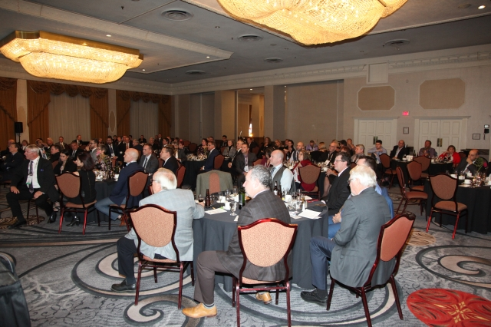
Canadian Association
of Movers
2018 Annual Conference

Slide 85
Canadian Association
of Movers
2018 Annual Conference

Slide 86
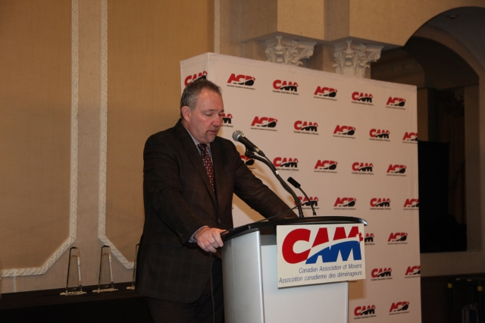
Canadian Association
of Movers
2018 Annual Conference

Slide 87
Canadian Association
of Movers
2018 Annual Conference

Slide 88
Canadian Association
of Movers
2018 Annual Conference

Slide 89
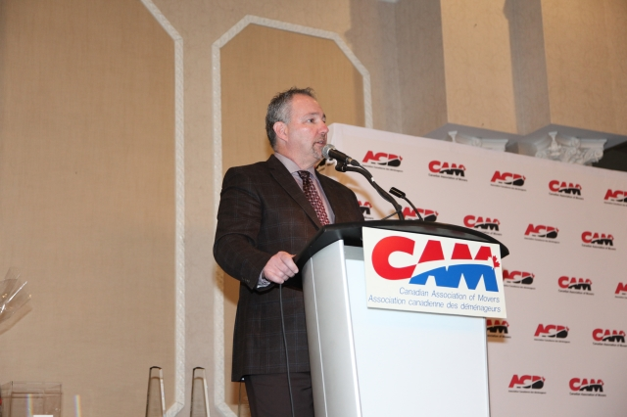
Canadian Association
of Movers
2018 Annual Conference

Slide 90
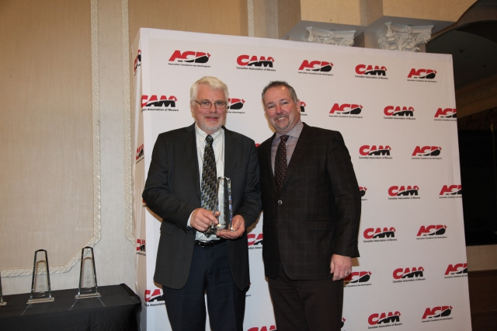
Canadian Association
of Movers
2018 Annual Conference

Slide 91
Canadian Association
of Movers
2018 Annual Conference

Slide 92
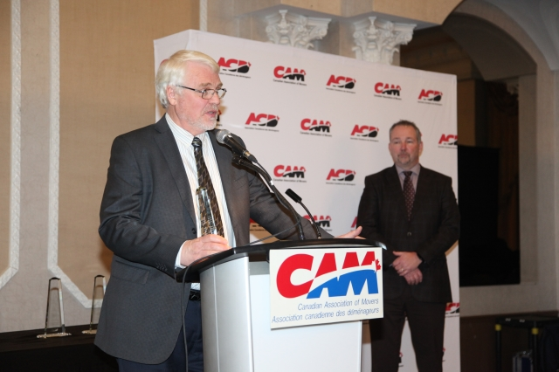
Canadian Association
of Movers
2018 Annual Conference

Slide 93
Canadian Association
of Movers
2018 Annual Conference

Slide 94
Canadian Association
of Movers
2018 Annual Conference

Slide 95
Canadian Association
of Movers
2018 Annual Conference

Slide 96
Canadian Association
of Movers
2018 Annual Conference

Slide 97
Canadian Association
of Movers
2018 Annual Conference

Slide 98
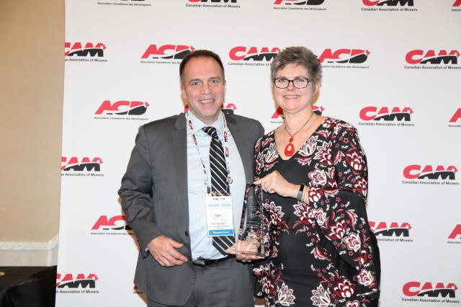
Canadian Association
of Movers
2018 Annual Conference

Slide 99
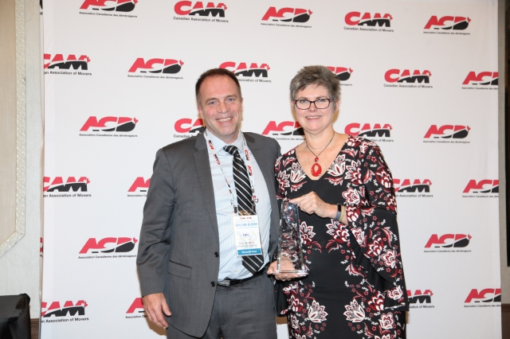
Canadian Association
of Movers
2018 Annual Conference

Slide 100
Canadian Association
of Movers
2018 Annual Conference

Slide 101
Canadian Association
of Movers
2018 Annual Conference

Slide 102
Canadian Association
of Movers
2018 Annual Conference

Slide 103
Canadian Association
of Movers
2018 Annual Conference

Slide 104
Canadian Association
of Movers
2018 Annual Conference

Slide 105
Canadian Association
of Movers
2018 Annual Conference

Slide 106
Canadian Association
of Movers
2018 Annual Conference

Slide 107
Canadian Association
of Movers
2018 Annual Conference

Slide 108
Canadian Association
of Movers
2018 Annual Conference

Slide 109
Canadian Association
of Movers
2018 Annual Conference

Slide 110
Canadian Association
of Movers
2018 Annual Conference

Slide 111
Canadian Association of Movers
2018 Annual Conference

Slide 112
Canadian Association
of Movers
2018 Annual Conference

Slide 113
Canadian Association
of Movers
2018 Annual Conference

Slide 114
Canadian Association
of Movers
2018 Annual Conference

Slide 115
Canadian Association
of Movers
2018 Annual Conference

Slide 116
Canadian Association
of Movers
2018 Annual Conference

Slide 117
Canadian Association
of Movers
2018 Annual Conference

Slide 118
Canadian Association
of Movers
2018 Annual Conference

Slide 119
Canadian Association
of Movers
2018 Annual Conference

Slide 120
Canadian Association
of Movers
2018 Annual Conference

Slide 121
Canadian Association
of Movers
2018 Annual Conference

Slide 122
Canadian Association
of Movers
2018 Annual Conference

Slide 123
Canadian Association
of Movers
2018 Annual Conference

Slide 124
Canadian Association
of Movers
2018 Annual Conference

Slide 125
Canadian Association
of Movers
2018 Annual Conference

Slide 126
Canadian Association
of Movers
2018 Annual Conference

Slide 127
Canadian Association
of Movers
2018 Annual Conference

Slide 128
Canadian Association
of Movers
2018 Annual Conference

Slide 129
Canadian Association
of Movers
2018 Annual Conference

Slide 130
Canadian Association
of Movers
2018 Annual Conference

Slide 131
Canadian Association
of Movers
2018 Annual Conference

Slide 132
Canadian Association
of Movers
2018 Annual Conference

Slide 133
Canadian Association
of Movers
2018 Annual Conference

Slide 134
Canadian Association
of Movers
2018 Annual Conference

Slide 135
Canadian Association
of Movers
2018 Annual Conference

Slide 136
Canadian Association
of Movers
2018 Annual Conference

Slide 137
Canadian Association
of Movers
2018 Annual Conference

Slide 138
Canadian Association
of Movers
2018 Annual Conference

Slide 139
Canadian Association
of Movers
2018 Annual Conference

Slide 140
Canadian Association
of Movers
2018 Annual Conference

Slide 141
Canadian Association
of Movers
2018 Annual Conference

Slide 142
Canadian Association
of Movers
2018 Annual Conference

Slide 143
Canadian Association
of Movers
2018 Annual Conference

Slide 144
Canadian Association
of Movers
2018 Annual Conference

Slide 145
Canadian Association
of Movers
2018 Annual Conference

Slide 146
Canadian Association of Movers
2018 Annual Conference

Slide 147
Canadian Association
of Movers
2018 Annual Conference

Slide 148
Canadian Association
of Movers
2018 Annual Conference

Slide 149
Canadian Association
of Movers
2018 Annual Conference

