Slide 1
THE CANADIAN MOVING INDUSTRY:
TIME FOR A CHANGE?
Conference November 18, 2019

Slide 2
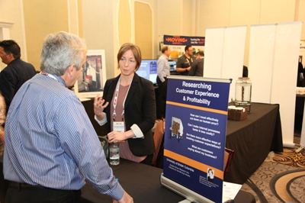
Asrai Ord
UBC student
data collected over 6-months
online survey in English & French
15% of our members were also one-on-one interviewed
60% van line affiliations

Slide 3
Survey Questions for Movers
Shipment Oversight
Item Loss
Moving Industry Reputation
Hiring and Efficiency

Slide 4
Shipment Oversight
85% wished they still had some control of their shipment once it left their hands to another company
only 25% were happy with their own company’s oversight
At least 50% want to maintain oversight on all of their shipments

Slide 5
Item Loss
All respondents indicted that time was spent trying to find lost items
Just over half indicated time was spent fixing the reason the item was misplaced
40% spent time disputing who misplaced the item
20% said their insurance costs went up as a result of the lost item

Slide 6
Moving Industry Reputation
0% said “well respected”
33% said “well respected, but needed improvement”
20% said “viewed negatively, but not worried”
40% said “viewed negatively, I am concerned”

Slide 7
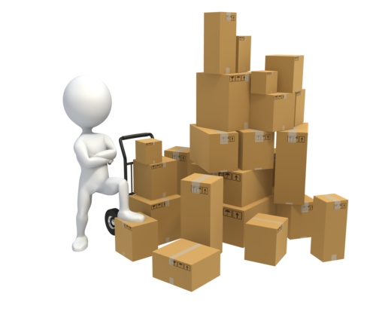
Hiring
90% found it very hard or hard to find good hires

Slide 8
Loss of Time or Money
74% tough industry competition
46% employee turnover
33% bad hires
33% paperwork errors

Slide 9
One-on-One Interviews Themed Responses
Reliability
Communication
Trust

Slide 10
Most Common Concerns
Rogues
Falling sales and margins
Poor communication
Reliance on outdated business processes
Relationships with unreliable outcomes
Labour and driver shortages
= unable to meet customer expectations & quality of service

Slide 11
View from outside the industry
The industry looks dated, slow, and untrustworthy.
Consumers are attracted to the well-composed, efficient online services with built in accountability measures
Can the moving industry shift online?

Slide 12
Views From Outside: Technology
Technology outdated
New business practices developed by those outside the industry?
“Uber-ization” of the industry

Slide 13
Proposed solutions from inside the industry
Diversifying revenue streams
Pooling small shipments more effectively
Investing in more efficient technology
Shifting to a business model that offers:
more partial services
multimodal transportation

Slide 14
Some parting thoughts from Asrai
Why hasn’t the industry changed?
What are the biggest barriers to doing things differently?
Are the biggest barriers insurmountable?
Why aren’t you looking outside of the industry for inspiration?
Are the barriers that keep you from looking outside the industry for fresh ideas significant enough to actually stop you?
Will they stop someone else?

