Slide 1
Adapt Now! Practical Survival Steps
Mark Oakeshott
November 20, 2017

Slide 2
INTRODUCTION – MARK OAKESHOTT
1978 - 1991: Pickfords UK
Trainee……….…COD Sales Rep……….….Customer Service Manager
1991- 2008: NFC – Allied - SIRVA
Built the Allied Pickfords Network to over 40 countries…..Built out the Allied International Partnership Program………Integrated North American International
2009 – 2013: SIRVA
Managed SIRVA’s International Moving Network………….Ran SIRVA’s International Moving Division

Slide 3
INTRODUCTION – MARK OAKESHOTT
2014 – 2016: SIRVA
M&A………Acquired companies in Brazil, Germany and Switzerland
2016 – Present: Crater Group Co.
- Start up that has rapidly become the leader in the video survey space.

Slide 4
INTRODUCTION - AUDIENCE
How many of you are moving company owners?
How many of you are employees?
How many of you plan to be in business or employed in the industry in 5 years time?
CRITICAL THAT YOU POSITION YOUR BUSINESS FOR THE FUTURE

Slide 5
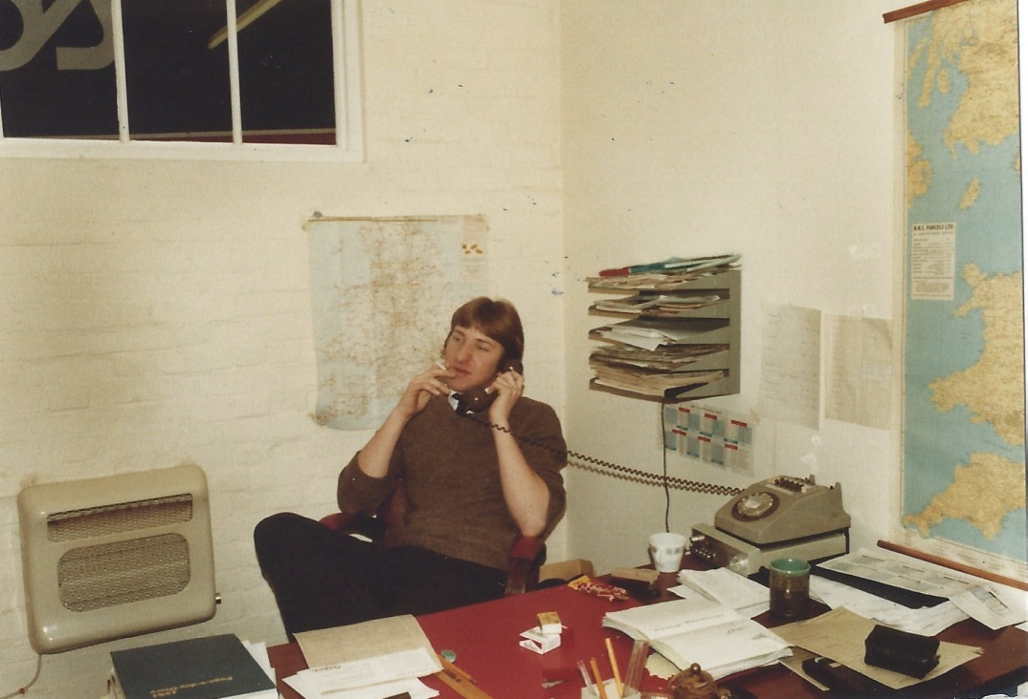
WHY IS THE MOVING INDUSTRY RIPE FOR DISRUPTION?

Slide 6
WHY IS THE MOVING INDUSTRY RIPE FOR DISRUPTION?
North America
$14 Billion Industry.
Highly Fragmented (Only 8.5% employ 100+ people).
No dominant brands.
Limited defensibility.
Poor sales experience for the consumer.
Moving companies are lagging way behind in adopting technology.
8,000 Moving Companies
7,000 Moving Companies
5,000 Moving Companies
1,000 Moving Companies
1,000 Moving Companies
1,000 Moving Companies

Slide 7
WHERE WILL THE THREAT COME FROM?
50-60 million Prime Members.
Trusted Brand.
People spend 5 x the average on home improvement when moving.
Strong understanding of supply chain.
Huge marketing “war chest”!

Slide 8
WHERE WILL THE THREAT COME FROM?
$11b Taxi Market
16 million customers
Aligned Technology
Supply Chain expertise
“Land and expand”
Got moving companies to give their product away.
Acquired IGC and ACI.
Sucking up data from your customers.

Slide 9
10 Practical Survival Steps

Slide 10
SURVIVAL STEP #1 – UNDERSTAND YOUR CUSTOMER

Slide 11
UNDERSTAND YOUR CUSTOMER (IS CHANGING!)
Millennial generation represents 26% of the Canadian population with 3 devices per person!
43% of all moves in North America in 2016 were millennials!
People spend an average of 5 hours a day on their smart phone!

Slide 12
SURVIVAL STEP #2 – QUICKLY ADOPT MOBILE COMMUNICATION
People spend an average of 5 hours a day on their smart phone!
Ask the customer how they want to communicate with you (Phone – Text – Email).
Make sure your web-site is designed for mobile.

Slide 13
SURVIVAL STEP #3 – DATA……DATA…….DATA
It is imperative to build data! Every interaction you have with a customer is an opportunity to learn more about them.
What does your customer look like (age, demographics)?
Where are they moving from?
What are your closing ratio’s in specific demographics/areas?
How does your customer choose to communicate?
Time of day and days of the week your prospects are actively shopping?

Slide 14
SURVIVAL STEP # 4 – UNDERSTAND YOUR CAC
Corporations
Price
Compliance
RMC’s
Price
Compliance
Moving Company
Price
Consumer

Slide 15
UNDERSTAND YOUR CAC
Across Each Segment
Consumer
Corporate
Military/Government
High Touch
Fully Burdened Cost
Cost of Leads
Sales Salaries
Auto Expense
Marketing
Media
Overhead
Conventions
T & E
Coffee Machine!
FRICTION
Life Time
Value
Margin $
Field Sales
Inside Sales
Low Touch
Cost to Acquire and Maintain a Customer $

Slide 16
SURVIVAL STEP #5 - ADOPT COMMON SENSE SOLUTIONS
Will this reduce my costs?
Will this improve the experience for some or all of my customers?
Am I locking myself into technology that will become outdated?
Virtual Surveys
Easy to use.
No upfront costs.
Costs $20-$90 vs. $150+ for In-Home.
30% of customers choose evenings and weekends for their survey.
Customers Love It! Customers rate the virtual survey experience 4.7 Stars (83 Net Promoter Score).

Slide 17
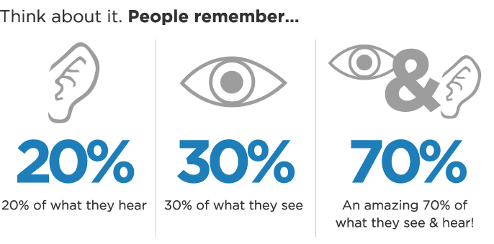
SURVIVAL STEP #6 – USE VIDEO IN MARKETING
The statistics for the impact of video driving sales are staggering:
33% of all online activity is spent watching video.
90% of users say that a video is helpful in the decision process.
An introductory company email that includes a video receives an increase click-through rate by 96%

Slide 18
SURVIVAL STEP #7 - FOCUS ON REVIEWS
Fact: 47% of Canadian consumers conduct on-line research before buying and 70% trust consumer opinions
Actively manage reviews.
Encourage reviews from all your customers.
Respond quickly to any adverse comments.
Don’t get mad – respond constructively as “the owner”.

Slide 19
SURVIVAL STEP #8 - EMBRACE THE NEW BUSINESS MODEL
That “Kodak Moment”
Kodak invented the digital camera.
Kodak invested $ Billions in development.
Kodak acquired “Ofoto” (photo-sharing site) in 2001.
Failed to realize that photo-sharing was the new business.
Ask Yourself 3 Questions
What business are we in today? Define the problem you are solving for customers.
What new opportunities does the disruption open up? Disruption is a great growth opportunity.
What capabilities do we need to realize these opportunities? Incumbents are best positioned to seize disruptive opportunities!

Slide 20
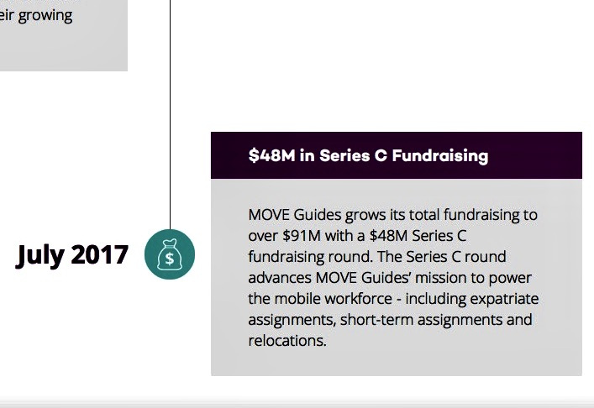
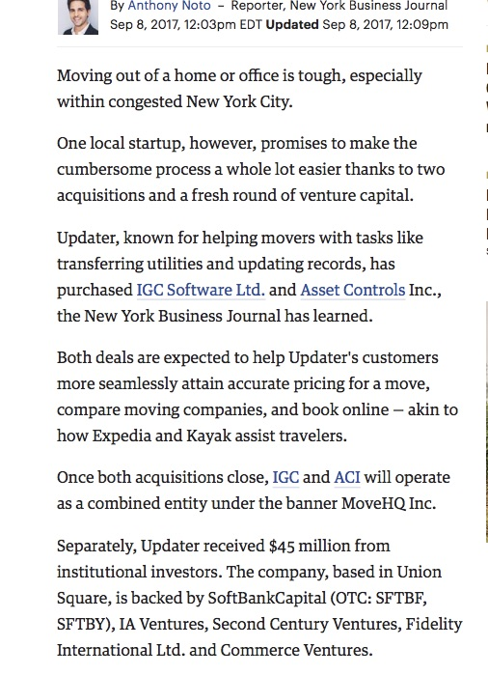
SURVIVAL STEP #9 – KEEP YOUR EYES WIDE OPEN
Google Alerts
LinkedIn

Slide 21
SURVIVAL STEP #10 - DON’T LET THIS BE YOU

Slide 22
Mark Oakeshott
mark@crater.co

